Slide 1
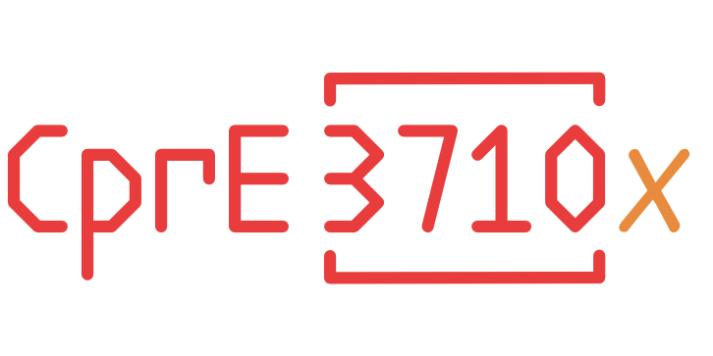
Implement and Test a Curriculum Around the i281e CPU
sdmay25-31
Ariana Dirksen, Gigi Harrabi, Tessa Morgan, Ethan Uhrich
Professor Alexander Stoytchev

Slide 2
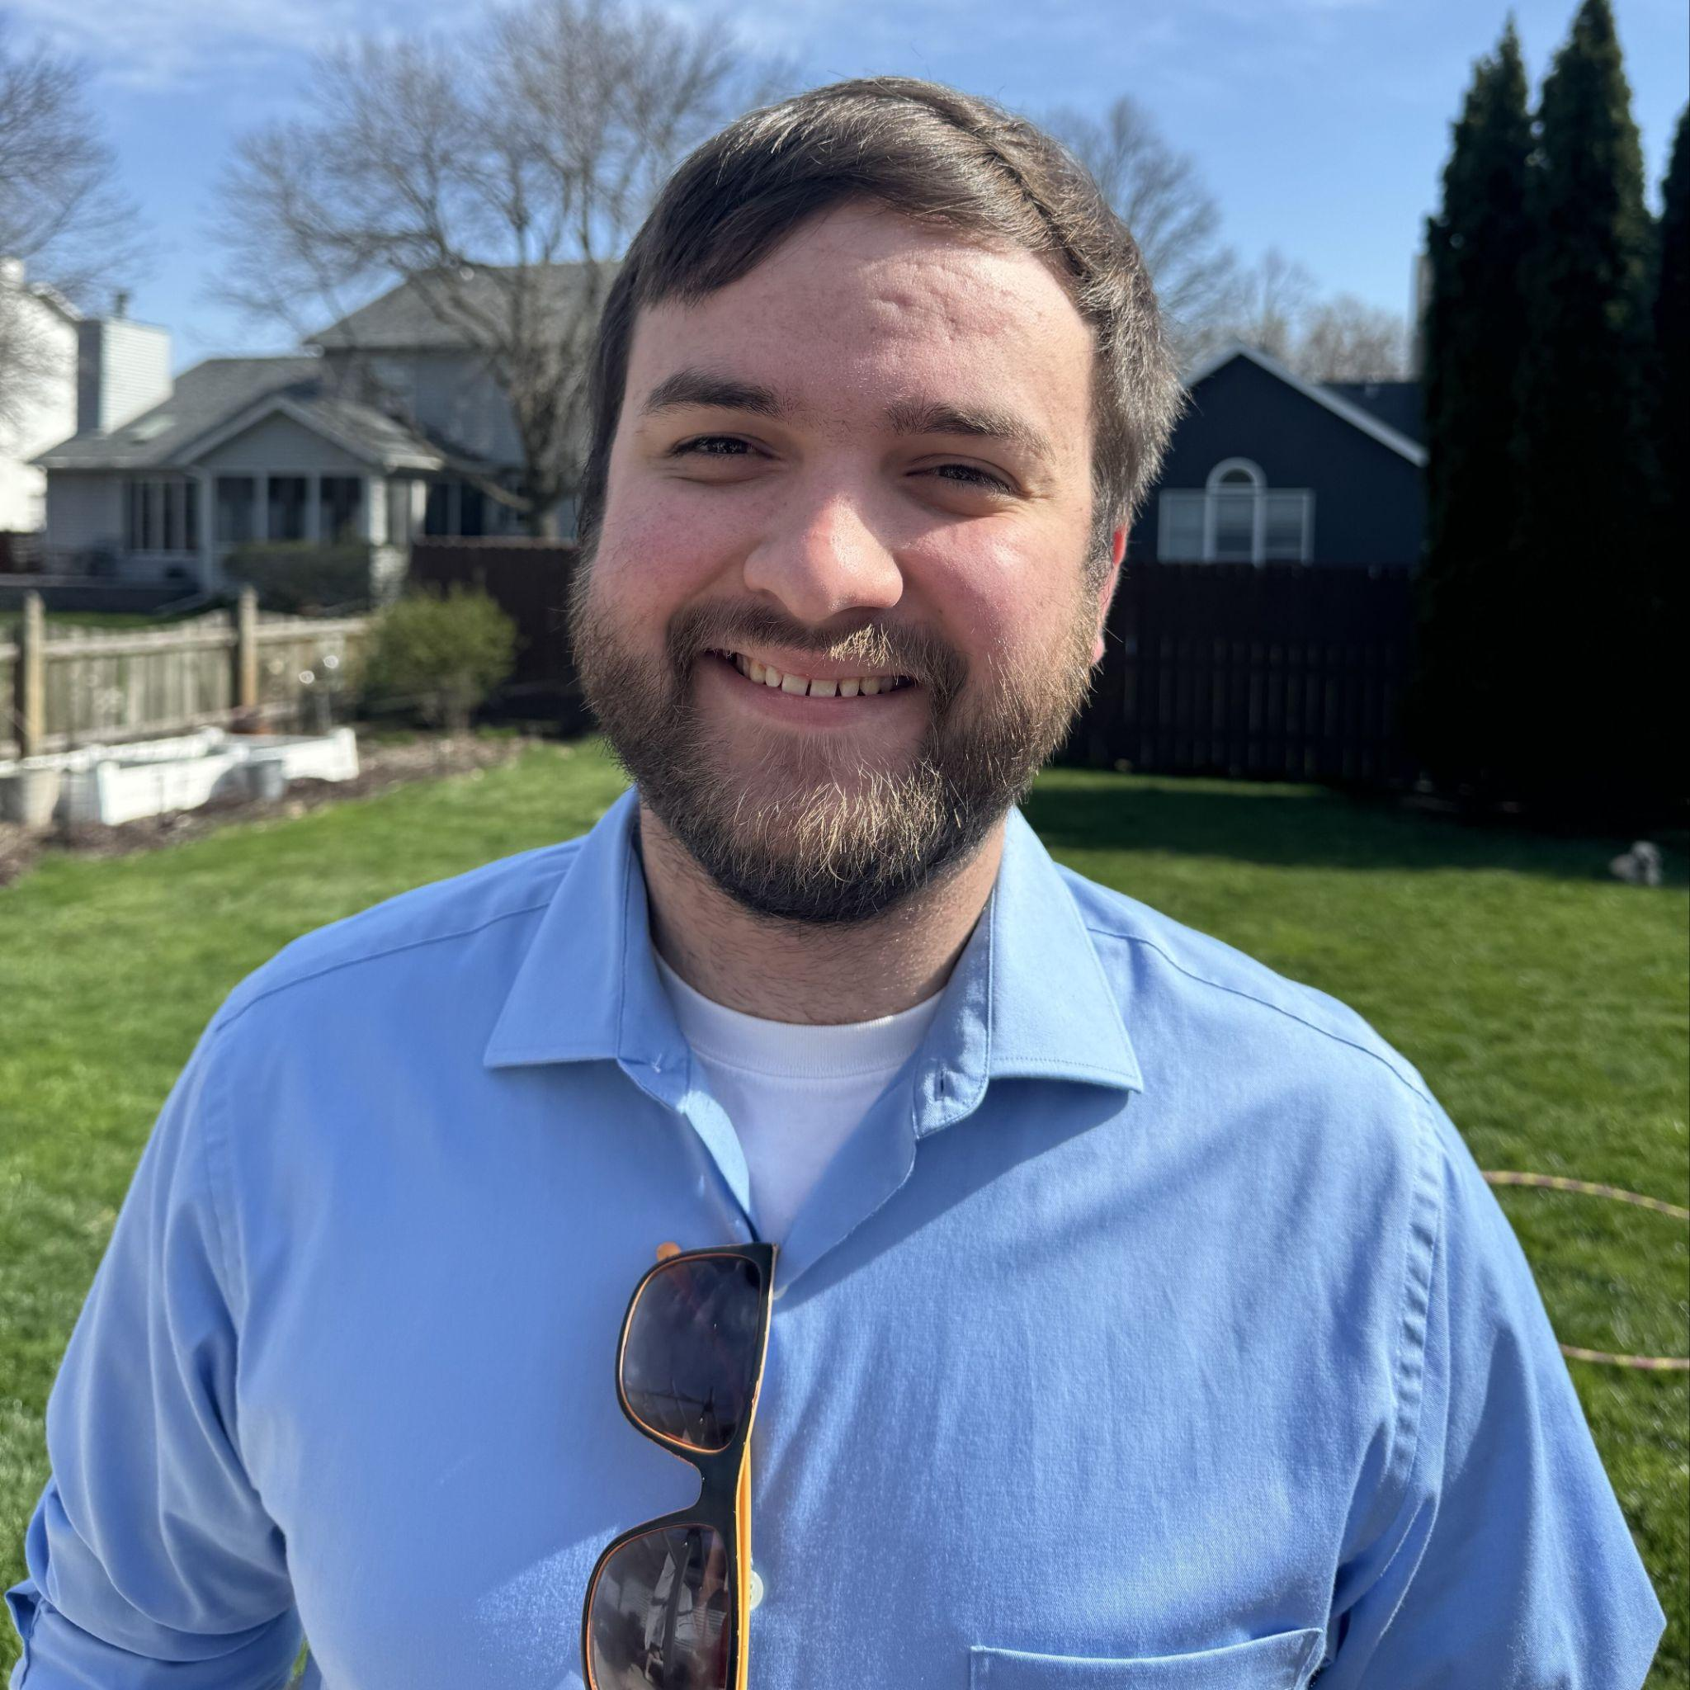
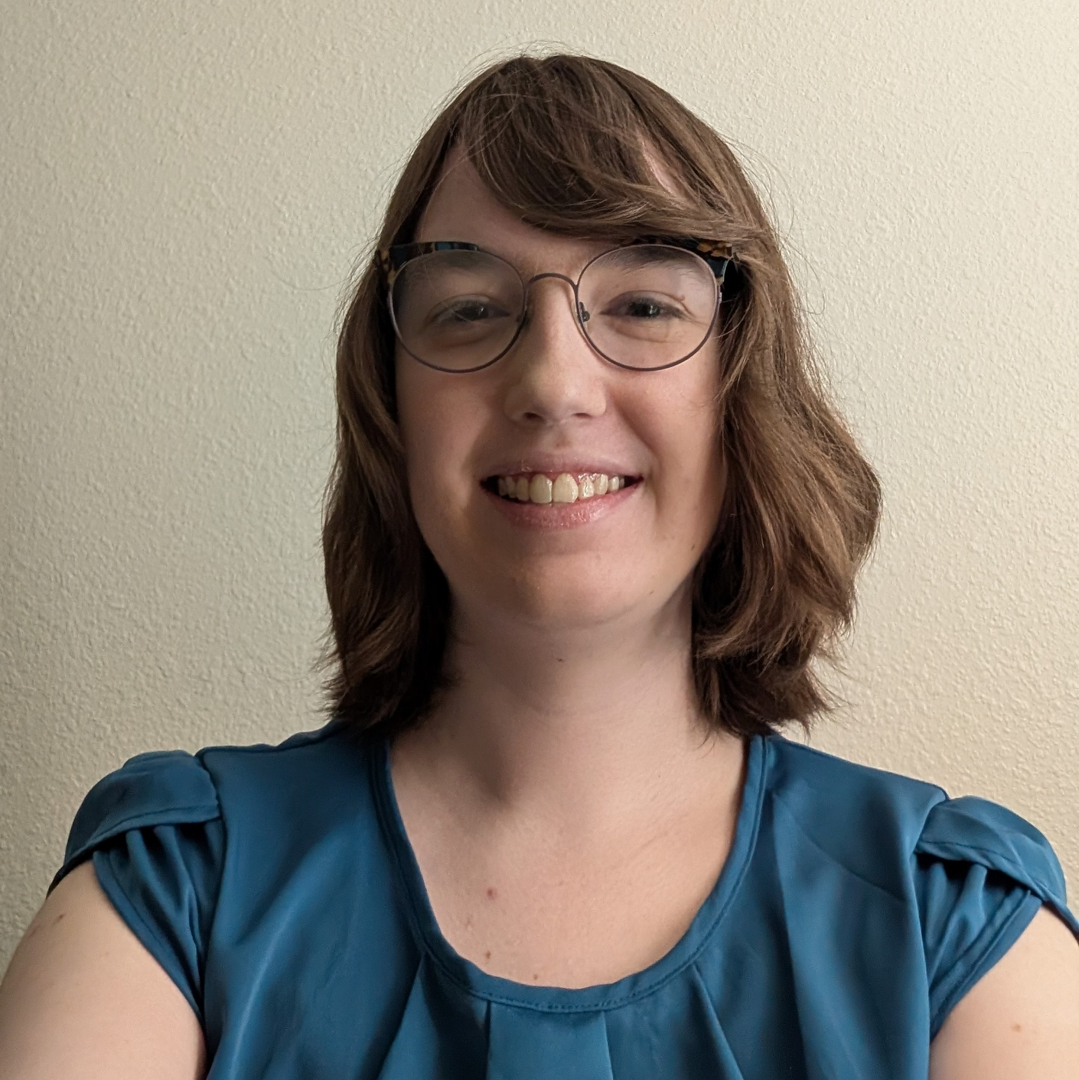
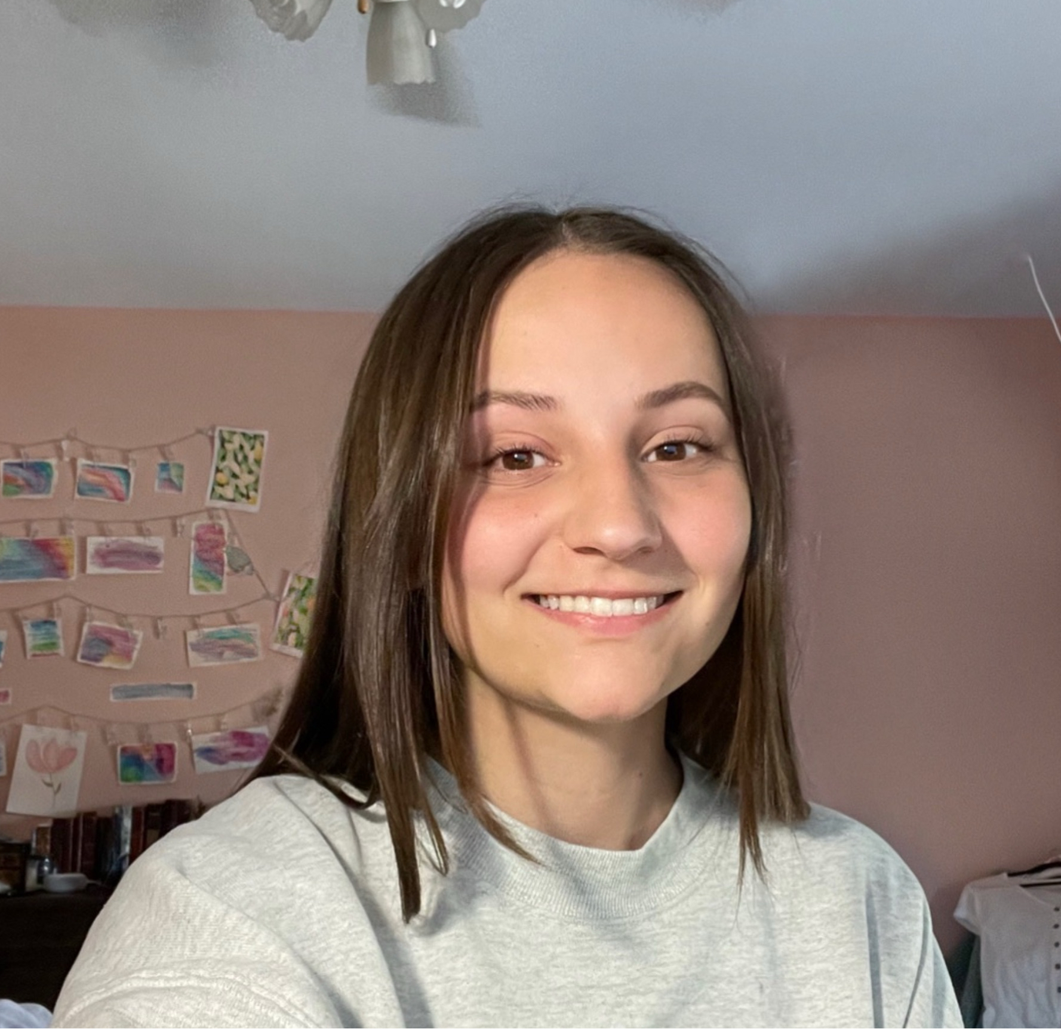
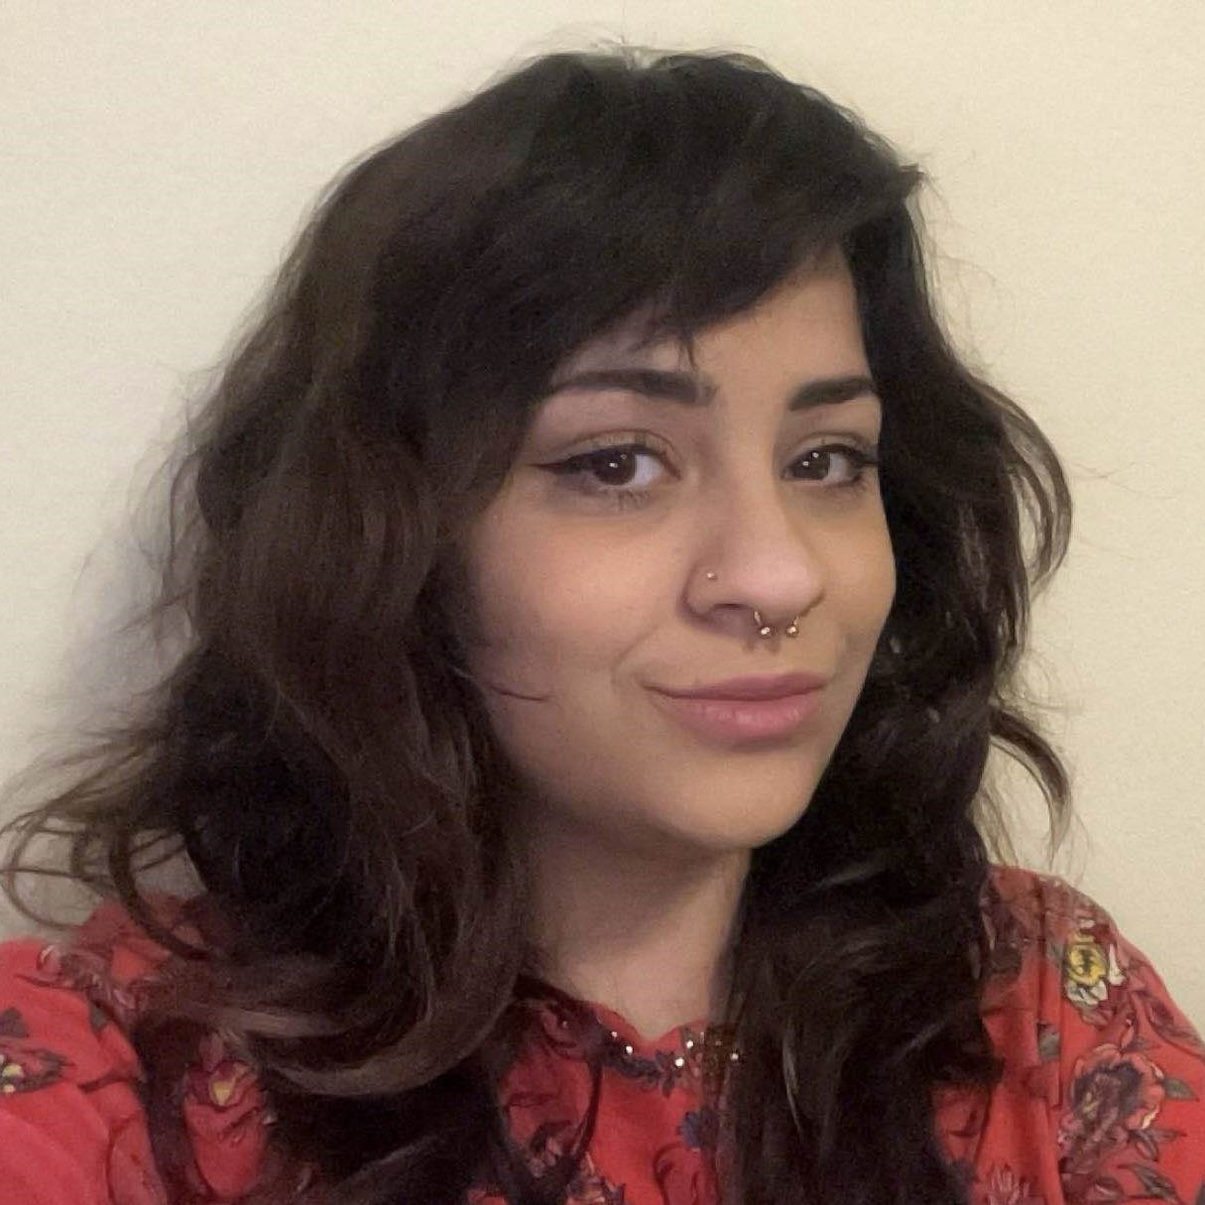
Team Composition
Ethan Uhrich
Team Lead
Treasurer
Computer Engineer
Ariana Dirksen
Editor
Note Taker
Computer Engineer
Tessa Morgan
Webmaster
Graphic Designer
Computer Engineer
Gigi Harrabi
Client Interaction Lead
Outreach Coordinator
Computer Engineer

Slide 3
Background

Slide 4
Historic Timeline
FPGA Implementation
(Summer 2019)
i281 Simulator
(May 2021)
First i281 Breadboard Implementation
(Dec 2023)
First i281e PCB Implementation
(May 2024)
Our Group -
Lab Designs
(May 2025)
CPRE 3710x
(Spring 2026)

Slide 5
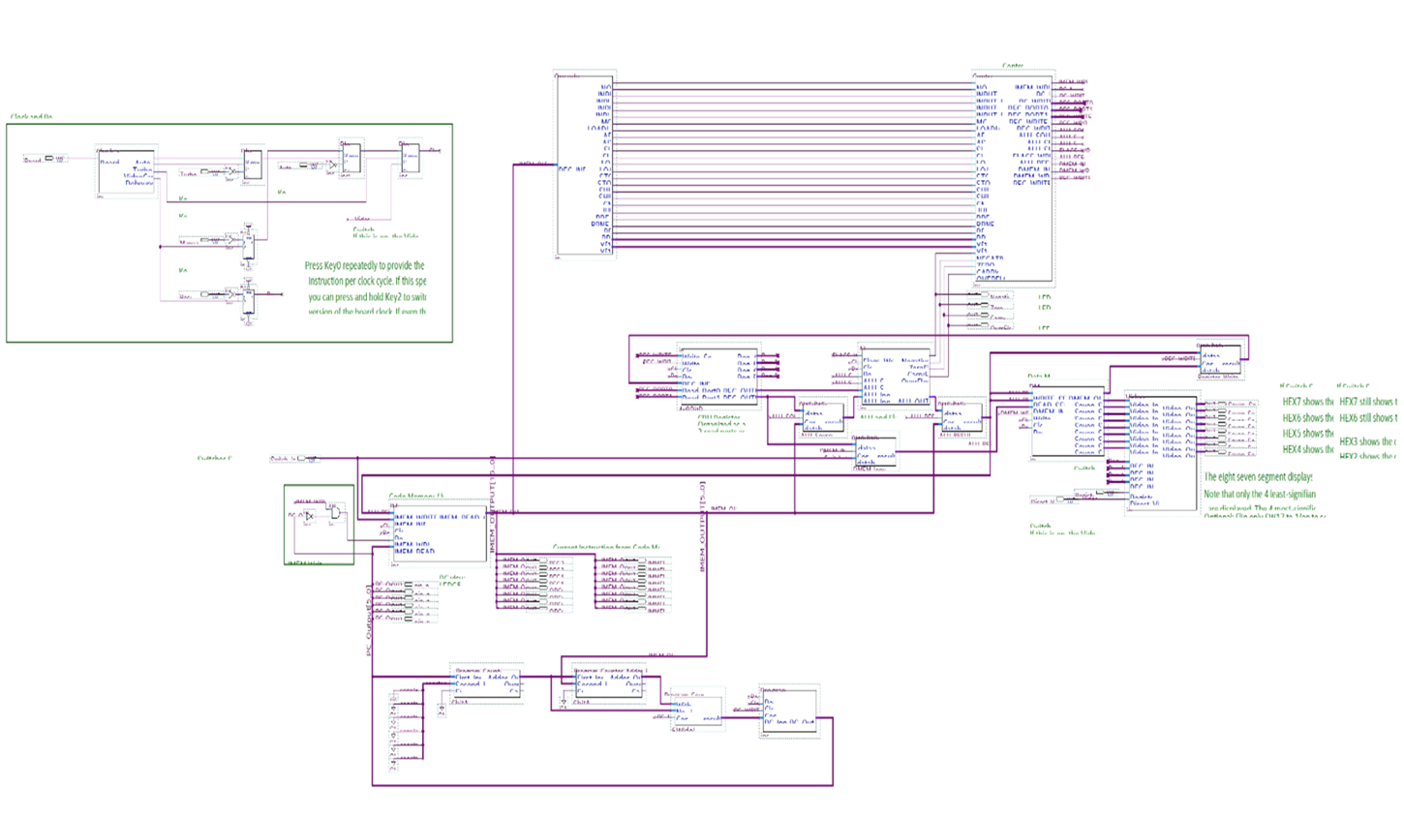
FPGA Implementation- Summer 2019

Slide 6
Historic Timeline
FPGA Implementation
(Summer 2019)
i281 Simulator
(May 2021)
First i281 Breadboard Implementation
(Dec 2023)
First i281e PCB Implementation
(May 2024)
Our Group -
Lab Designs
(May 2025)
CPRE 3710x
(Spring 2026)

Slide 7
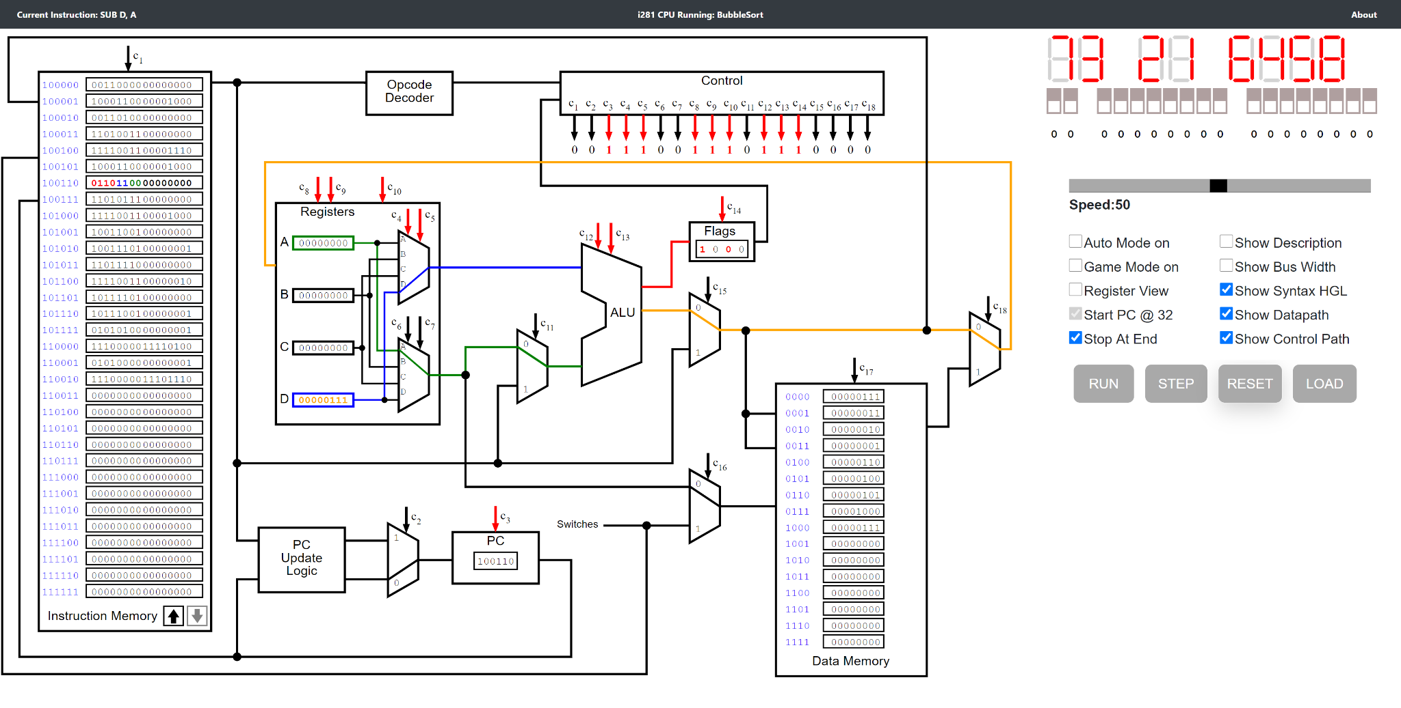
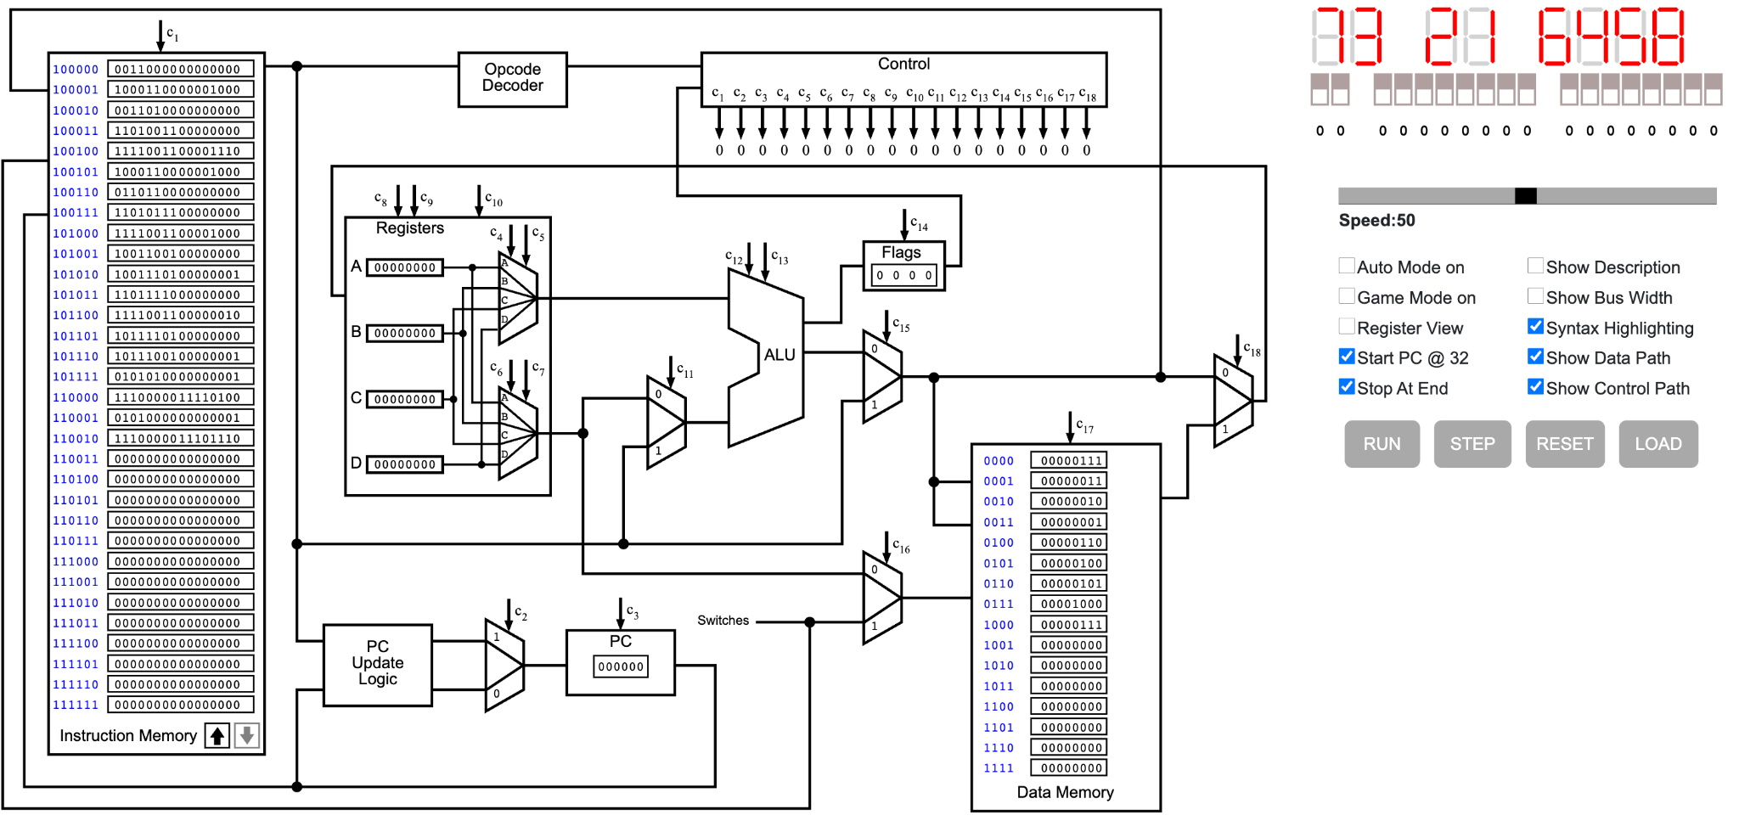
Simulator - May 2021

Slide 8
Historic Timeline
FPGA Implementation
(Summer 2019)
i281 Simulator
(May 2021)
First i281 Breadboard Implementation
(Dec 2023)
First i281e PCB Implementation
(May 2024)
Our Group -
Lab Designs
(May 2025)
CPRE 3710x
(Spring 2026)

Slide 9
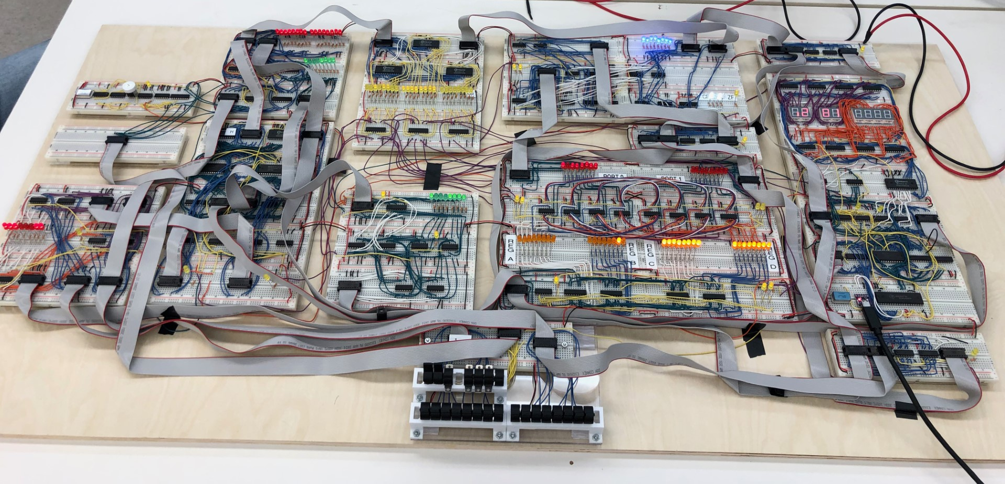
Breadboard Implementation - Dec 2023 to Feb 2024
Decoder
ALU
MUX
Clock
MUX
DMEM
Writeback
Code Memory
Program Counter
Registers
MUX
Switches/Front Panel
Notes:
[Logan] Intro Slide

Slide 10
Historic Timeline
FPGA Implementation
(Summer 2019)
i281 Simulator
(May 2021)
First i281 Breadboard Implementation
(Dec 2023)
First i281e PCB Implementation
(May 2024)
Our Group -
Lab Designs
(May 2025)
CPRE 3710x
(Spring 2026)

Slide 11
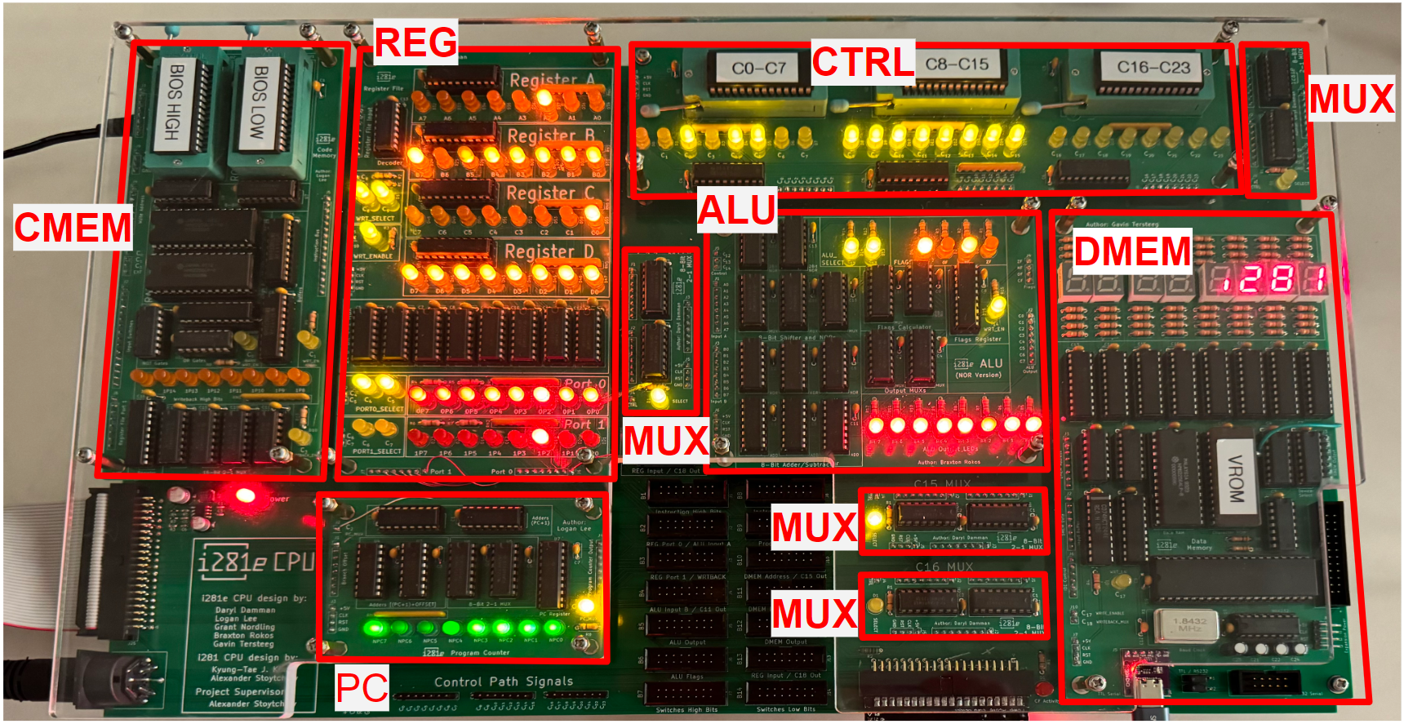
PCB Implementation - May 2024
Source: https://sdmay24-14.sd.ece.iastate.edu/
Notes:
[Logan] Intro Slide

Slide 12
Historic Timeline
FPGA Implementation
(Summer 2019)
i281 Simulator
(May 2021)
First i281 Breadboard Implementation
(Dec 2023)
First i281e PCB Implementation
(May 2024)
Our Group -
Lab Designs
(May 2025)
CPRE 3710x
(Spring 2026)

Slide 13
Historic Timeline
FPGA Implementation
(Summer 2019)
i281 Simulator
(May 2021)
First i281 Breadboard Implementation
(Dec 2023)
First i281e PCB Implementation
(May 2024)
Our Group -
Lab Designs
(May 2025)
CPRE 3710x
(Spring 2026)

Slide 14
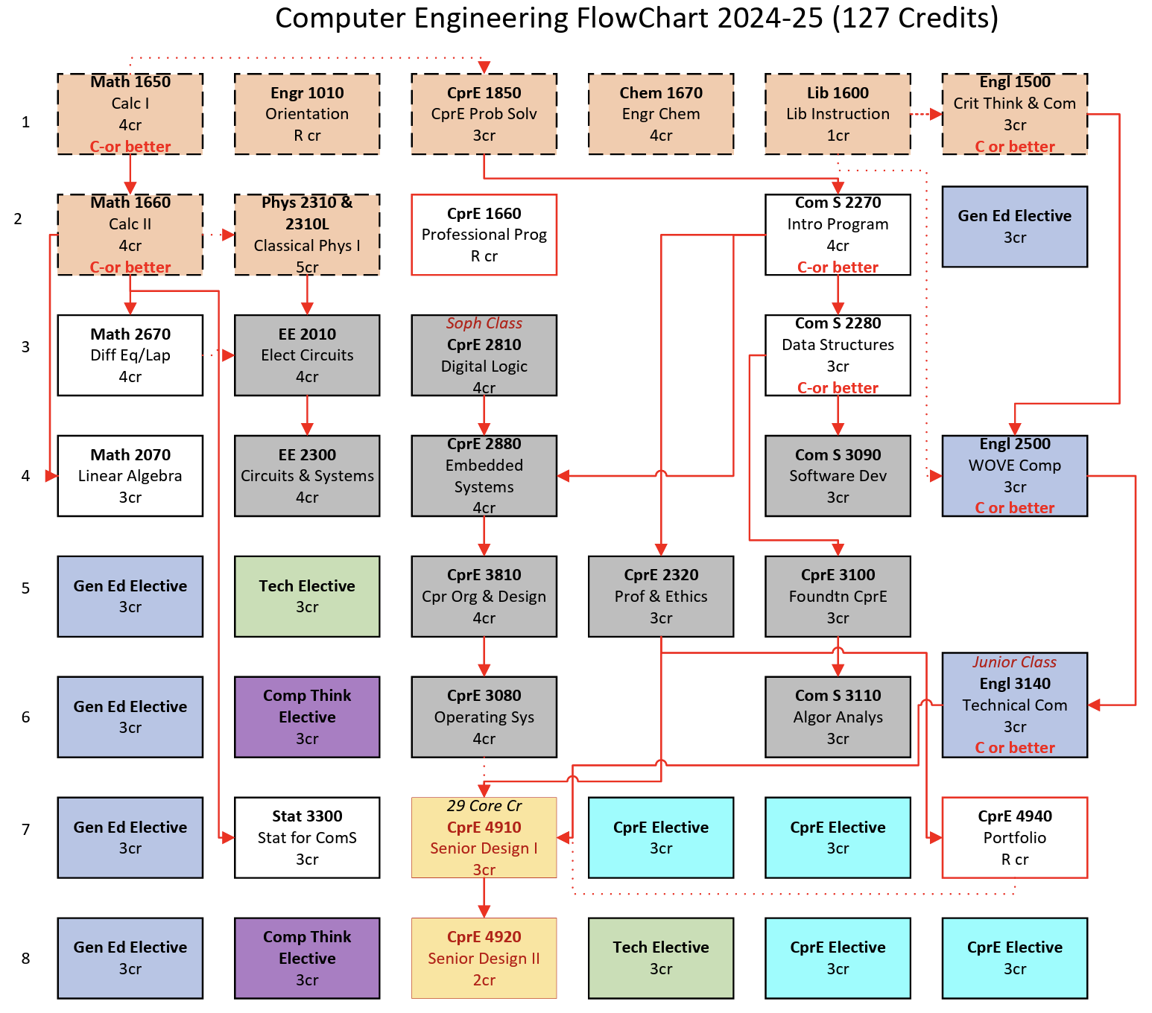
Curriculum
CprE 3710x
Microprocessors & Digital Circuits

Slide 15
Overview and Requirements

Slide 16
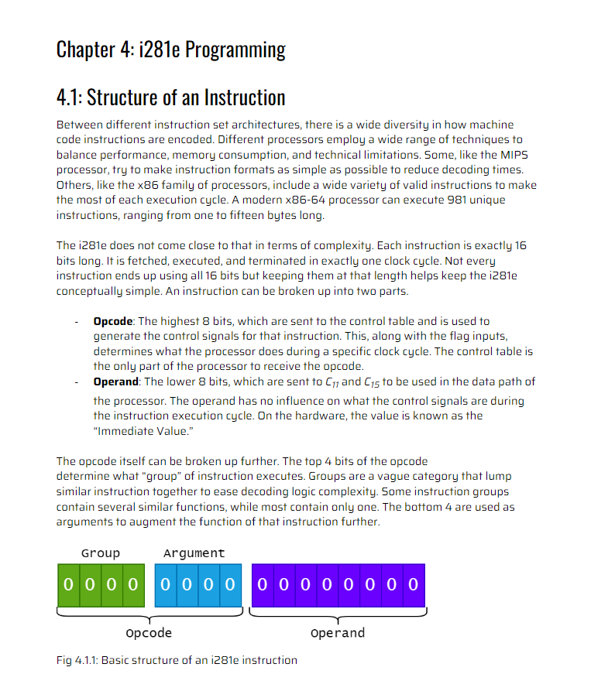
Existing Resources
GitLab
PCB Schematics
User Manual
Electronics and Technology Group (ETG)
Matthew Post, Leland Harker, Student Workers
Breadboard Implementation
Previous Team Websites
CprE 2810 Lectures
Professor Stoytchev

Slide 17
Project Proposal Summary
Goal: Take these open-source hardware and software designs and implement a set of curriculum and outreach activities around them
Each activity will be tested and documented in detail
These documents could also be used as educational materials for existing classes or to support future lectures and labs
A subset of these materials will be used for outreach activities

Slide 18
Project Proposal Summary Cont.
Design, create and test at least 10 labs/activities based around the i281e processor completable within a lab period (about 2 hours)
To be incorporated into a new class tentatively referred to as:
CprE 3710x : Microprocessors and Digital Circuits

Slide 19
Deliverables

Slide 20
Deliverables
Lab Instruction Manual
Background Information & Images
Step-by-Step Activity Instructions
Testing Guides
Lab Report
Pre-Lab Activities
Lab Questions
Grading Rubric & Answer Key
43 Minutes of Instruction Videos
150+ Pages
450+ MB
650 Hours

Slide 21
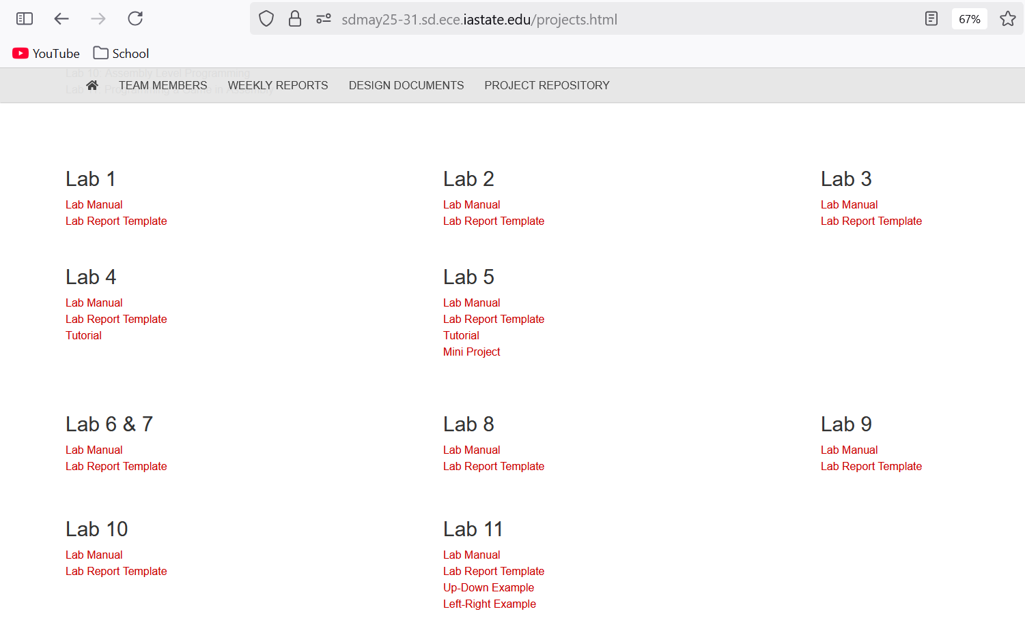

Slide 22
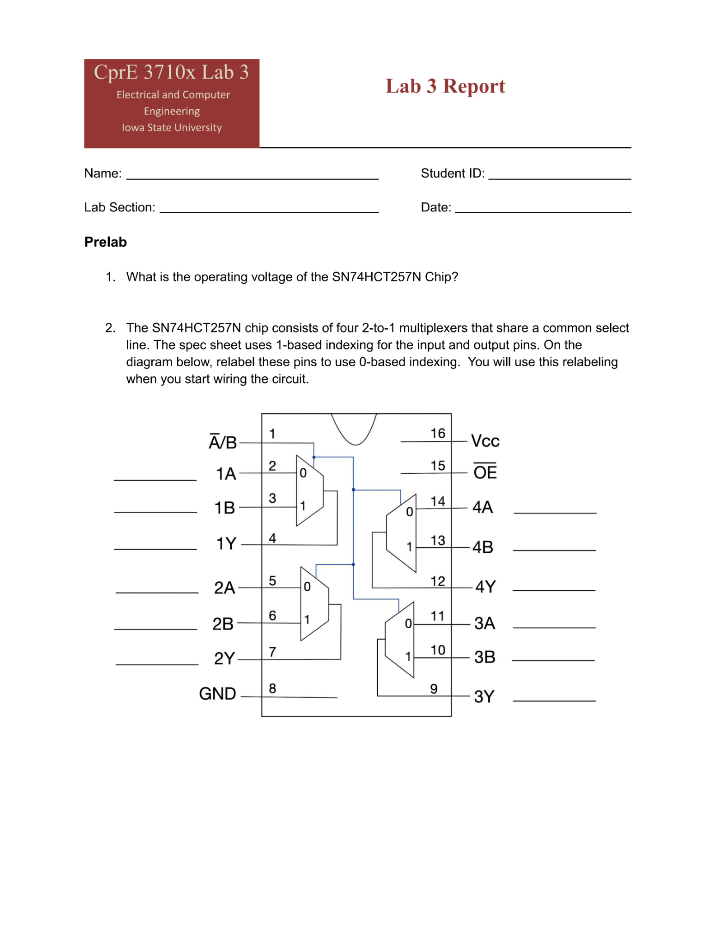
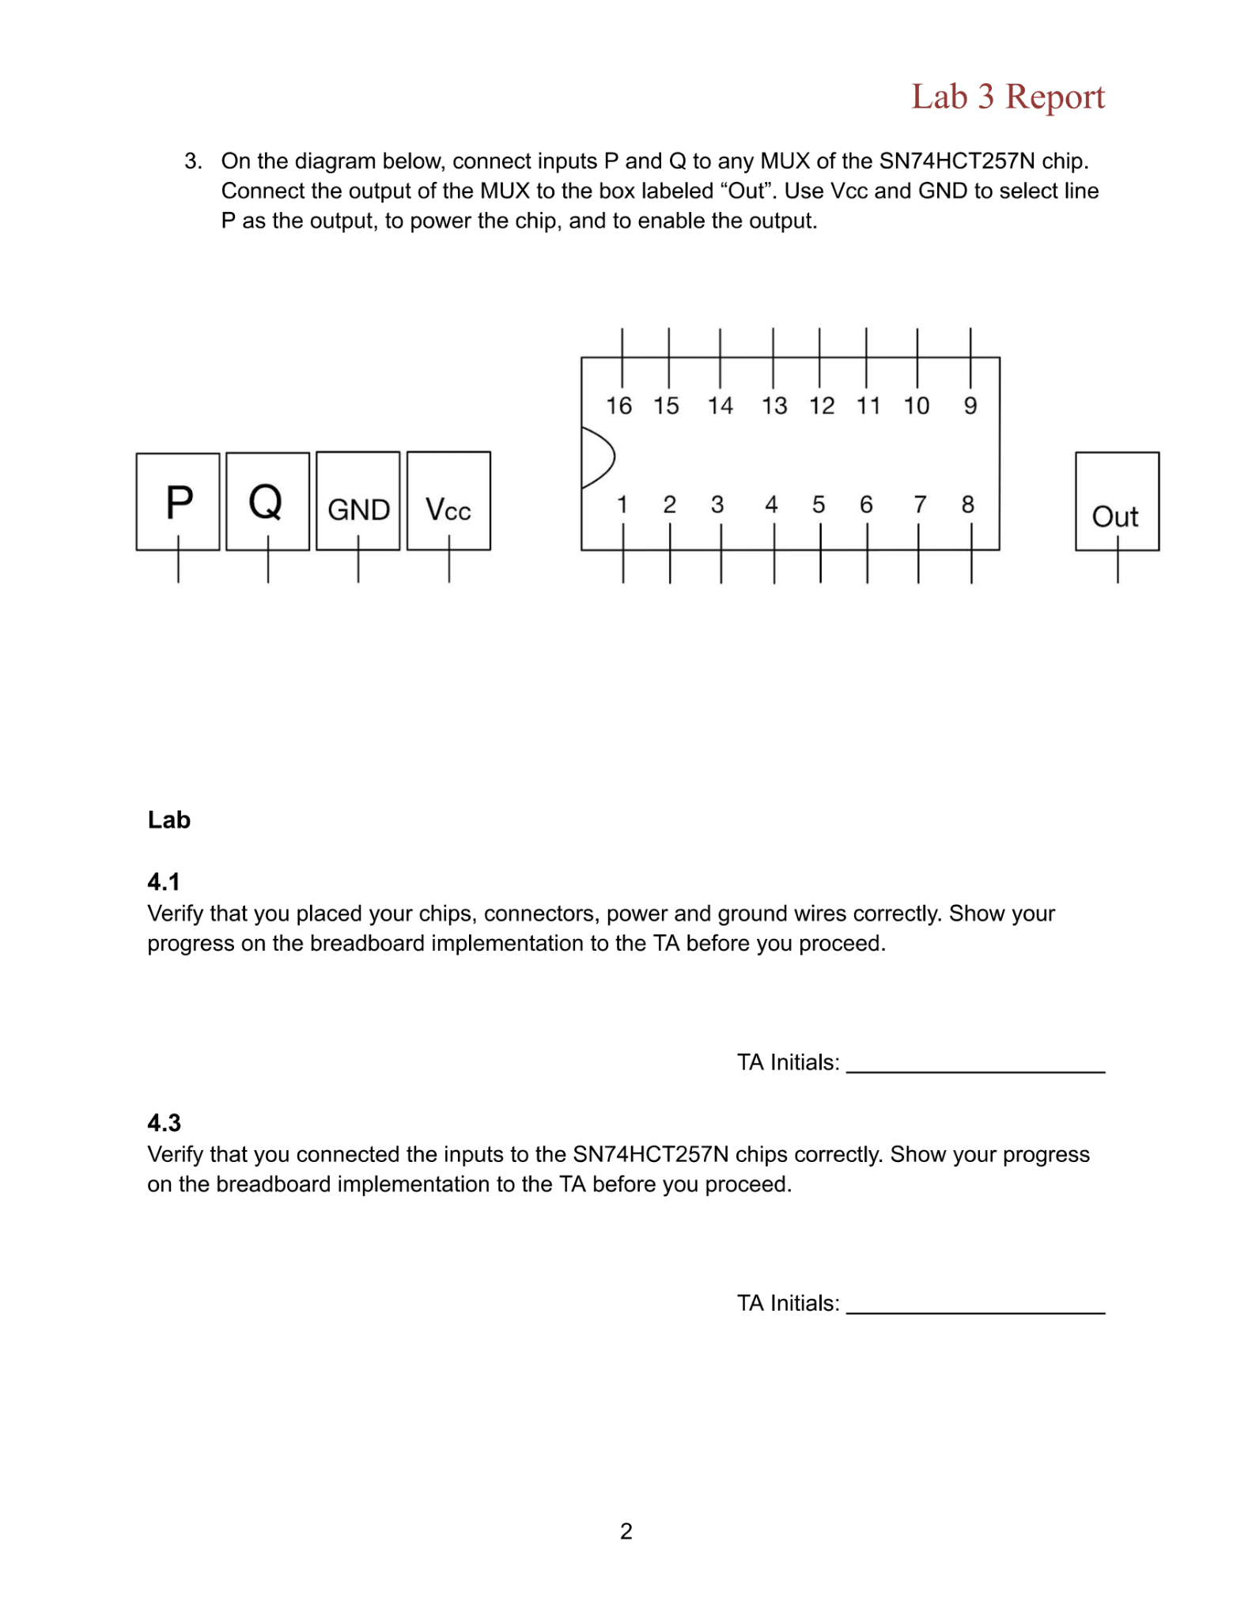

Slide 23
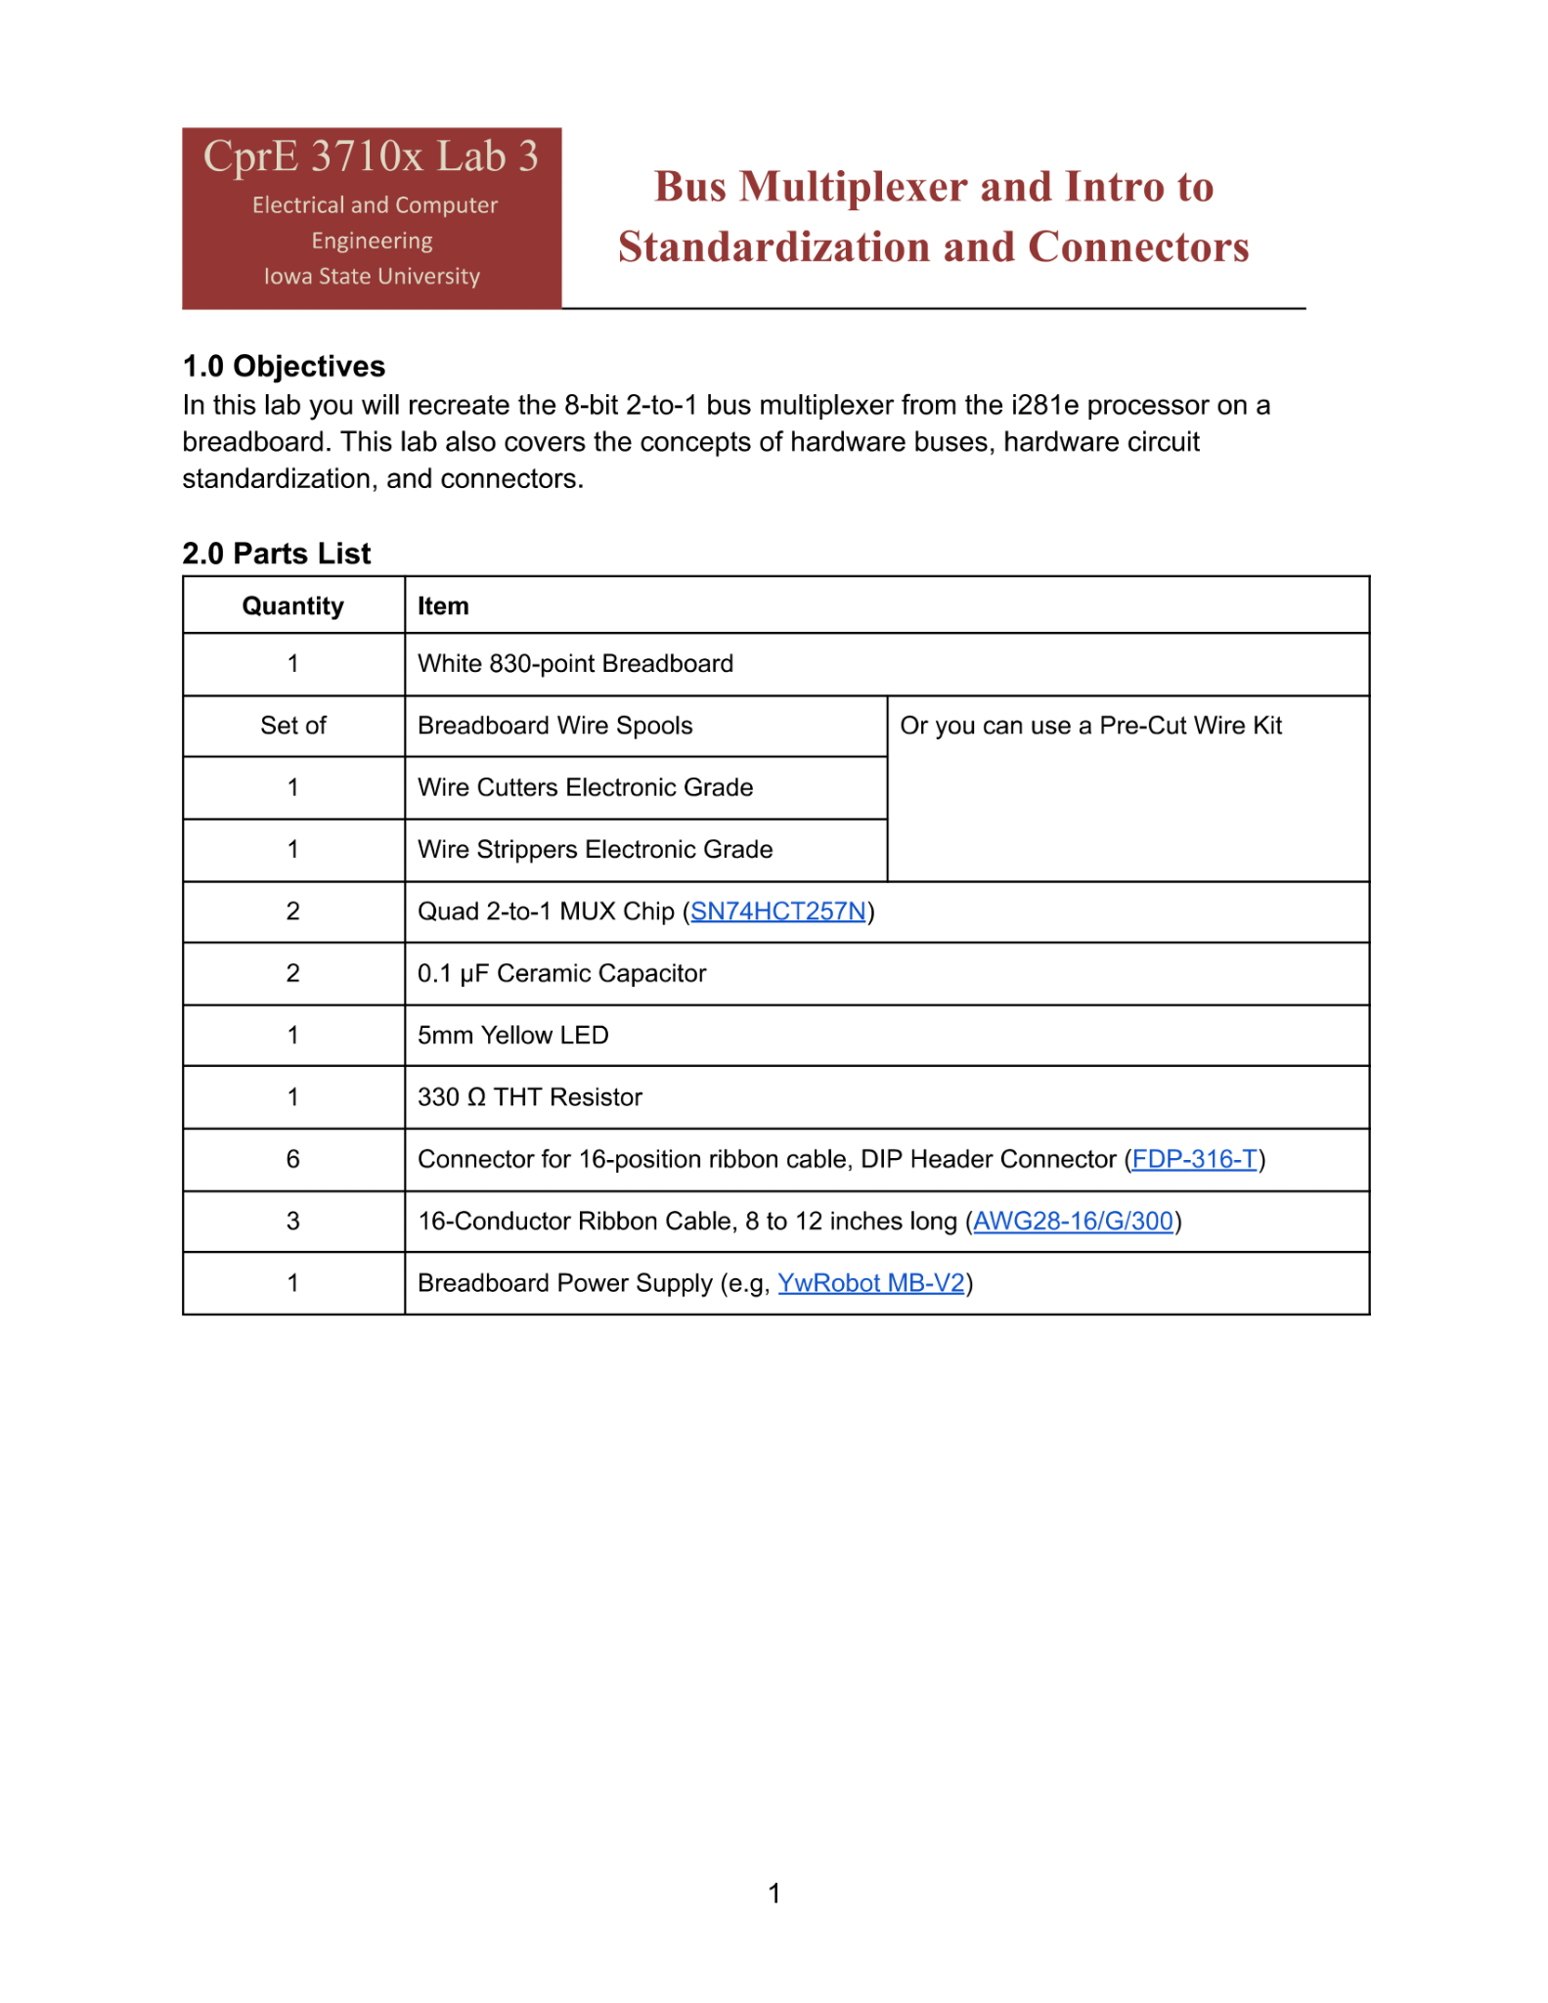

Slide 24
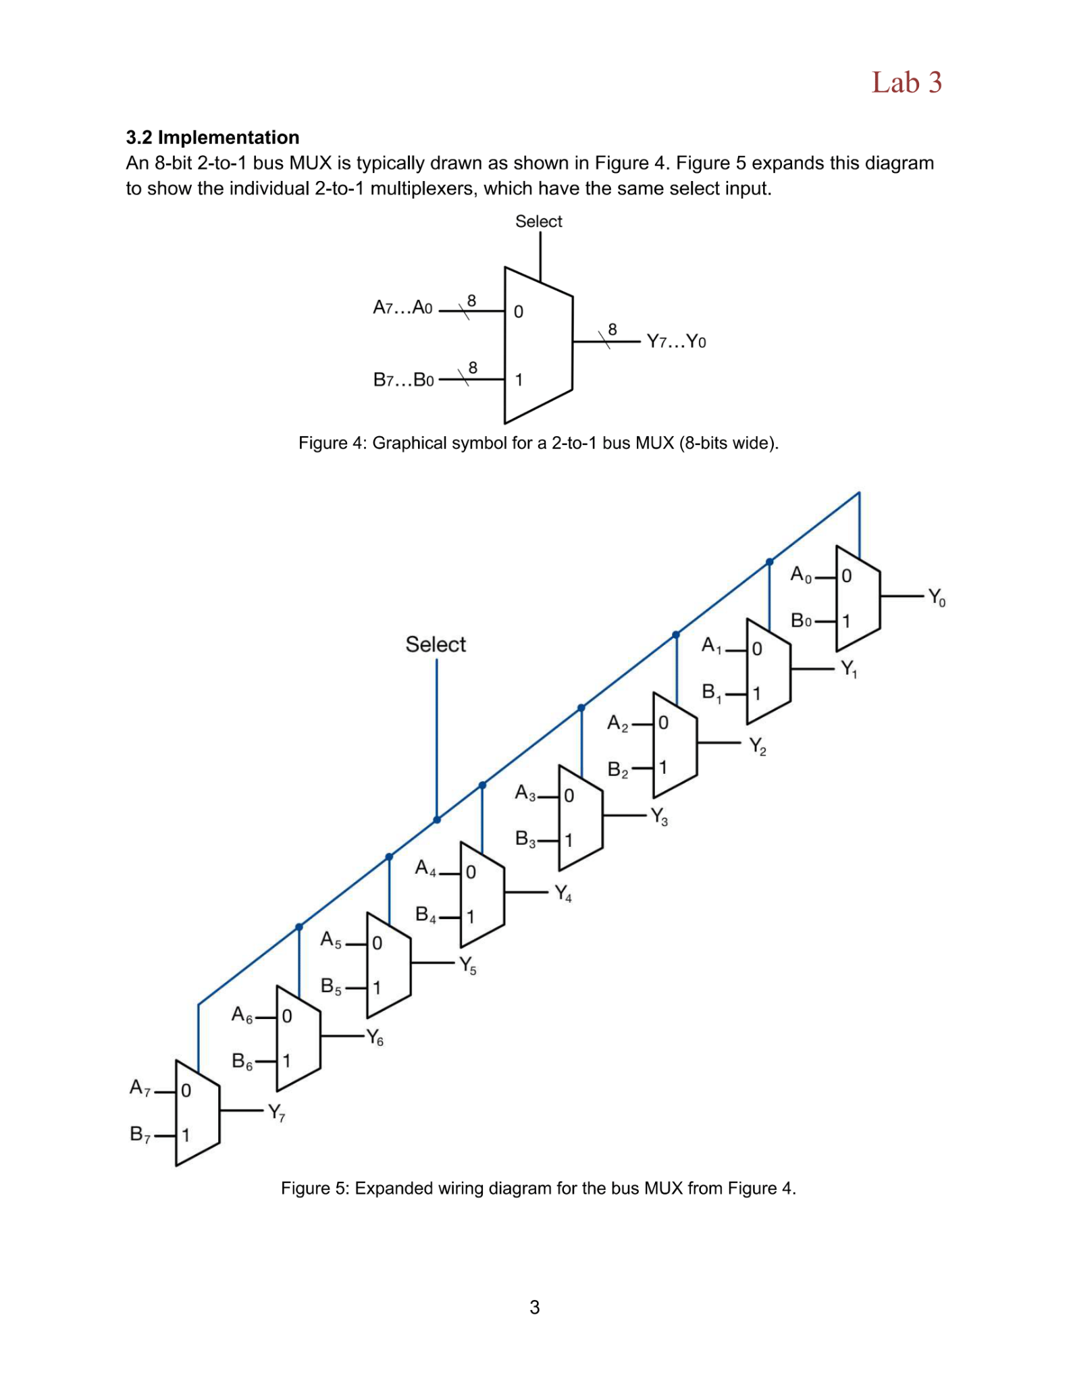
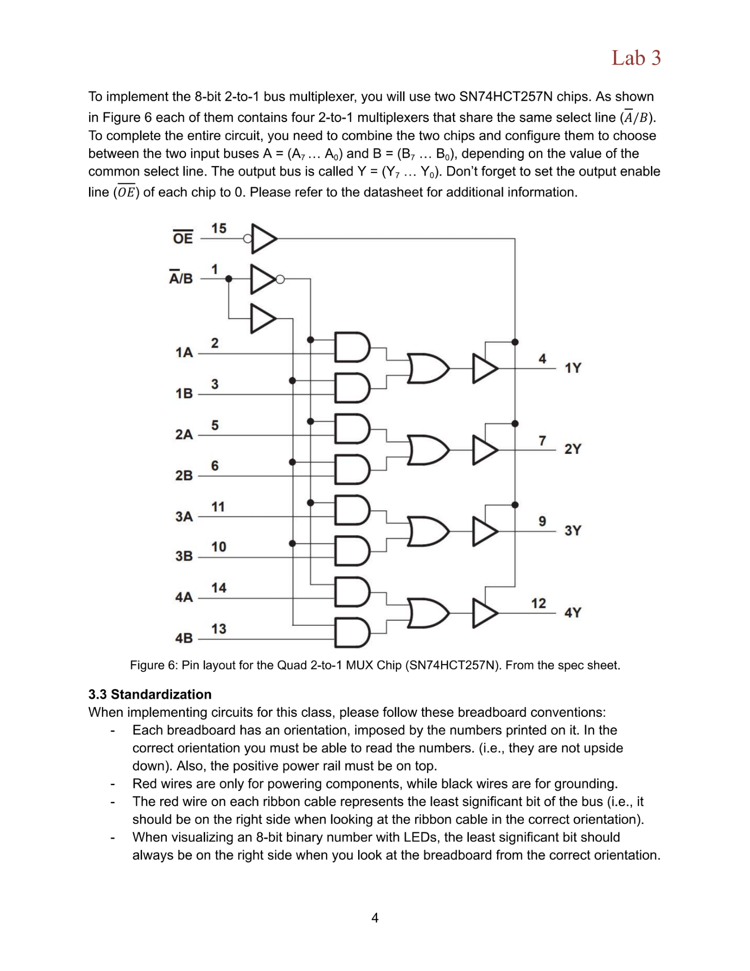

Slide 25
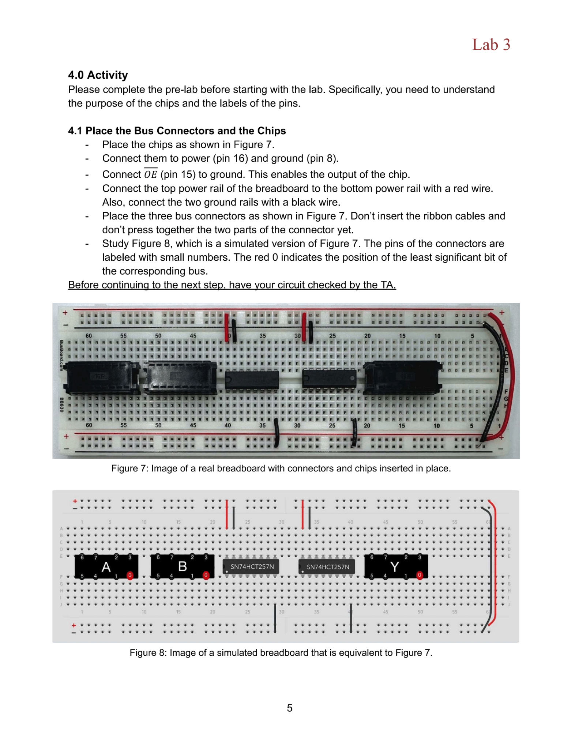
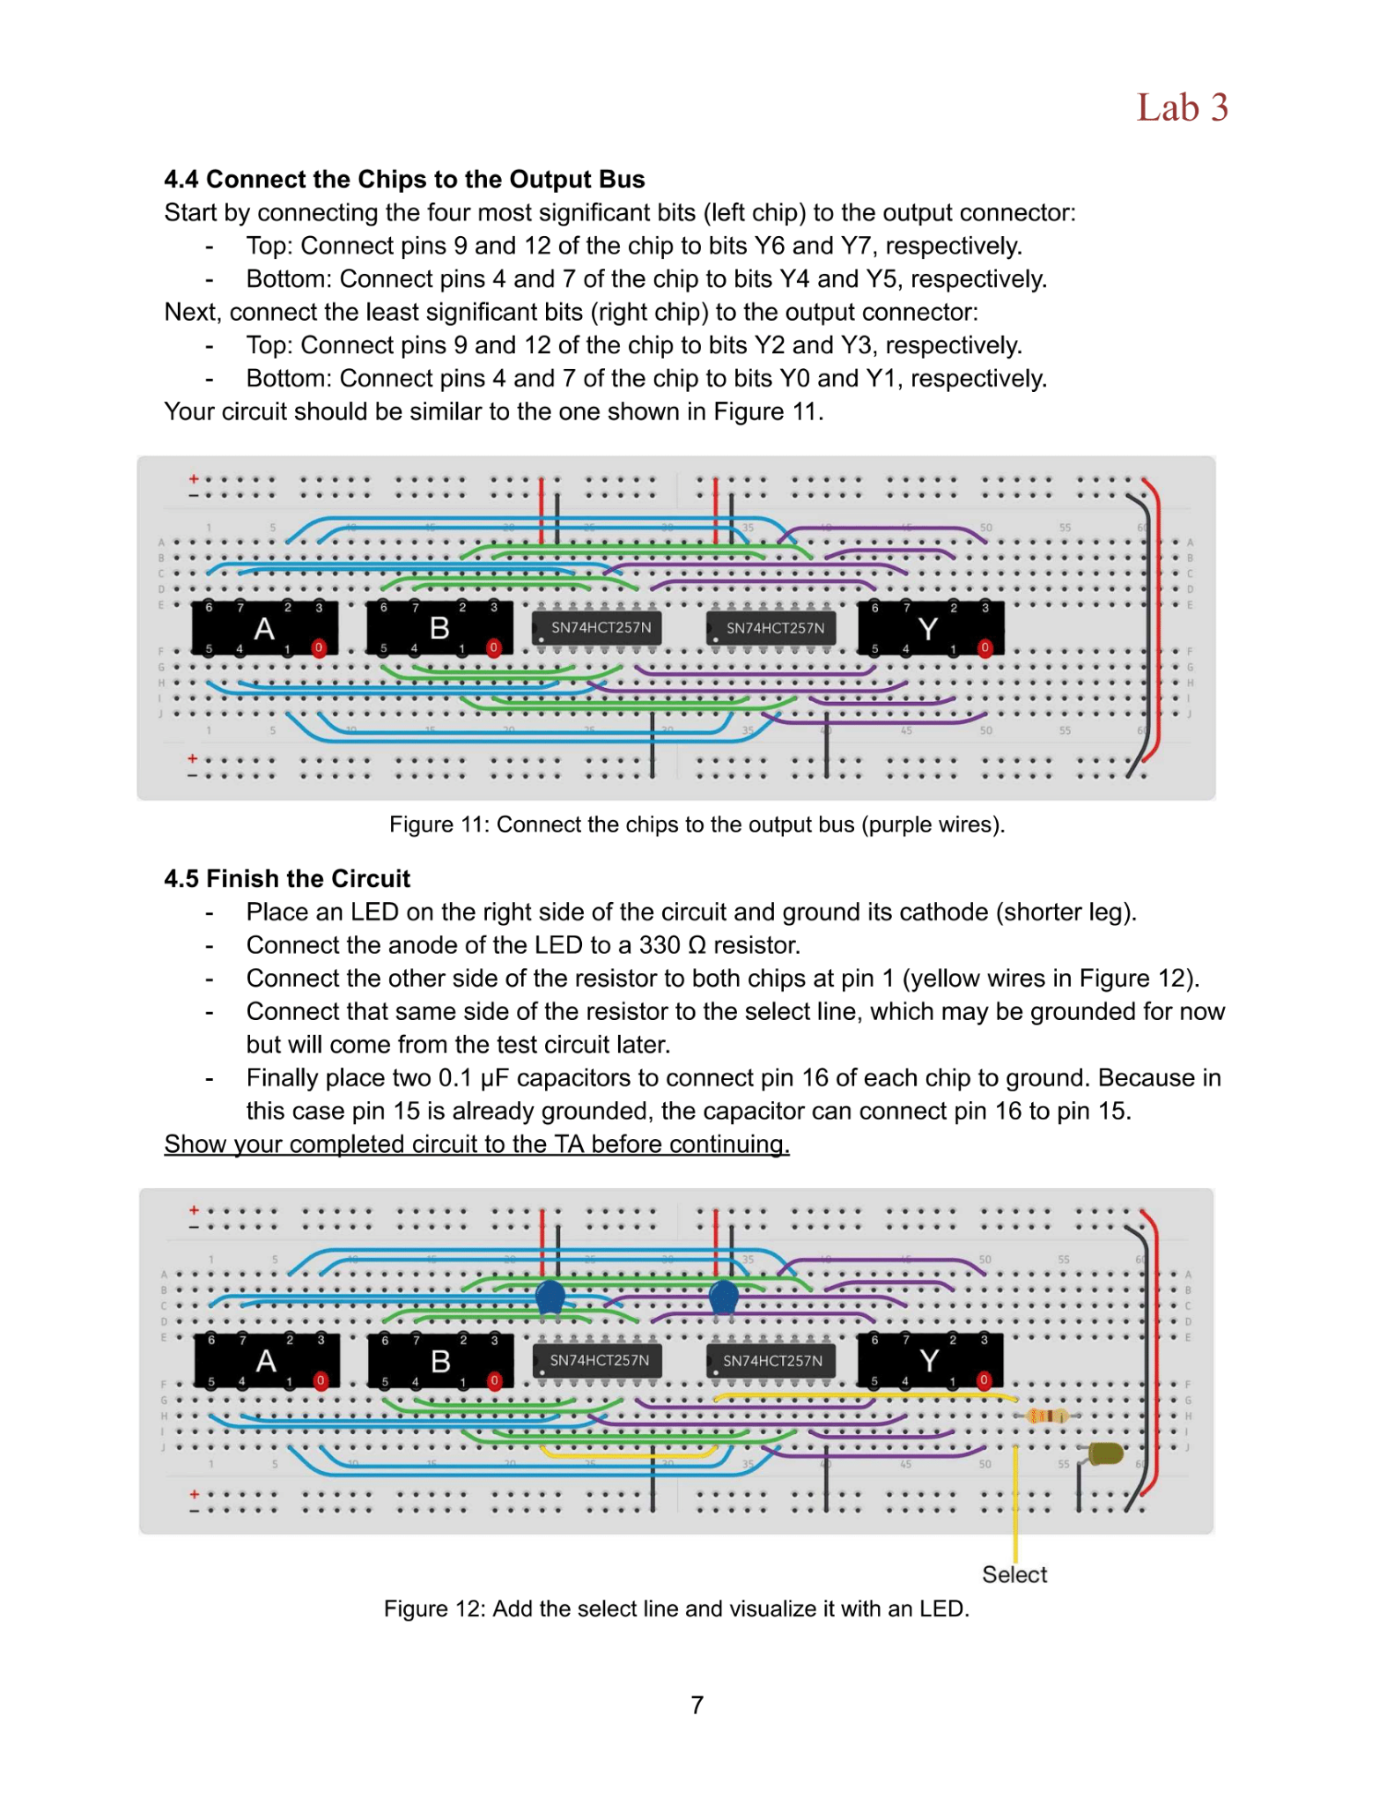

Slide 27
Considerations

Slide 28
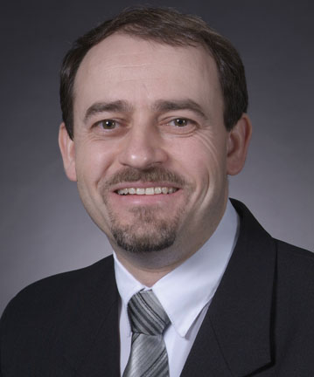
User Considerations
Primary
Prof. Stoytchev (Client)
Curriculum
Past i281 CPU Work
Undergraduate Students
Previous knowledge
Time constraints
Lab room constraints
Secondary
Teaching Assistants
Outreach Coordinators
Middle and High School students

Slide 29
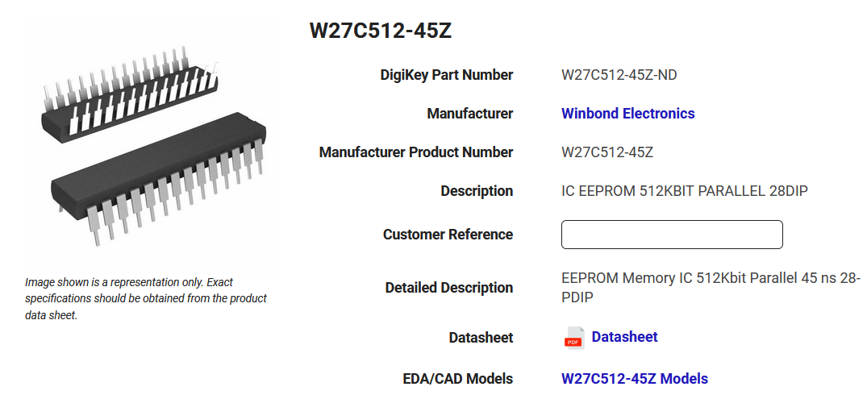
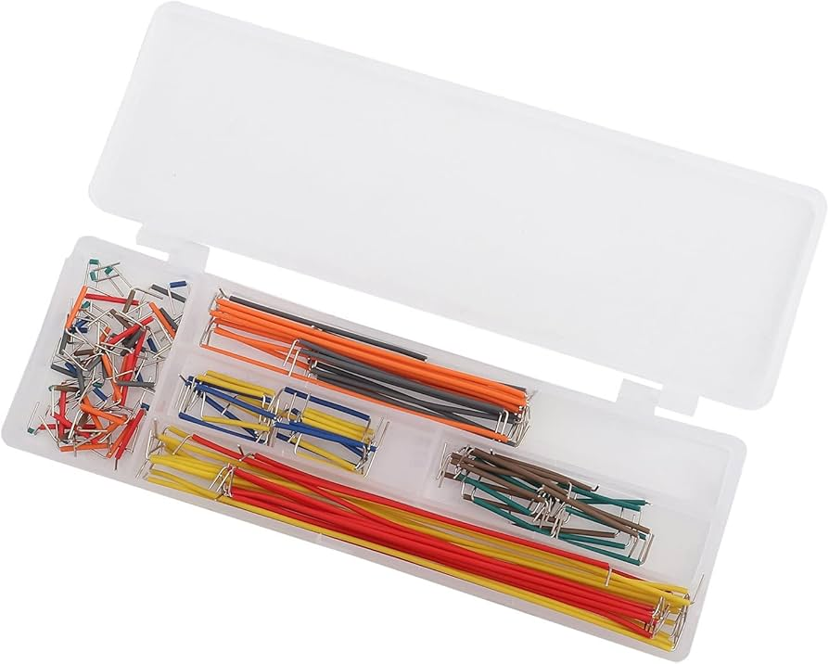
Hardware
Chips:
Need to be available with plenty of stock for the labs
Some chips used in i281e processor no longer in production (EEPROM)
Need to find replacements that are pin compatible to processor
Shipments to US are paused in China so it's hard to get necessary parts.
Wiring:
The lab room for the class might not allow for cutting wires
Wire kits have limited lengths and colors
Some hardware, like the power supply may short, causing delays in testing

Slide 30
Software

Slide 31
Design Process

Slide 32
Design Iterations
Flesh out lab requirements
Build or program first iteration
Test and debug iteration
Get feedback from team and client
Document and draft the lab
Test the Lab
Make Changes to iteration
Revise the Draft

Slide 33
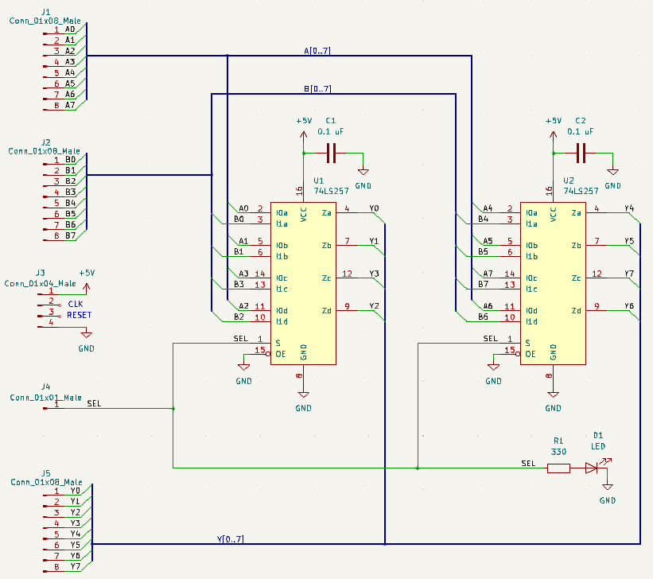
Flesh Out Lab Requirements
What do we want to accomplish with this lab?
What do the students need to learn?
How can we accomplish this?
What activities would help the students learn?
What clarifications need to be made?
Examples are from Lab 3.

Slide 34
Build or Code Our First Iteration
For Hardware Labs
Use pre-cut wires to build.
Verify that the parts on hand are correct.
For Software Labs
Attempt the activity and note what steps or considerations are made.

Slide 35
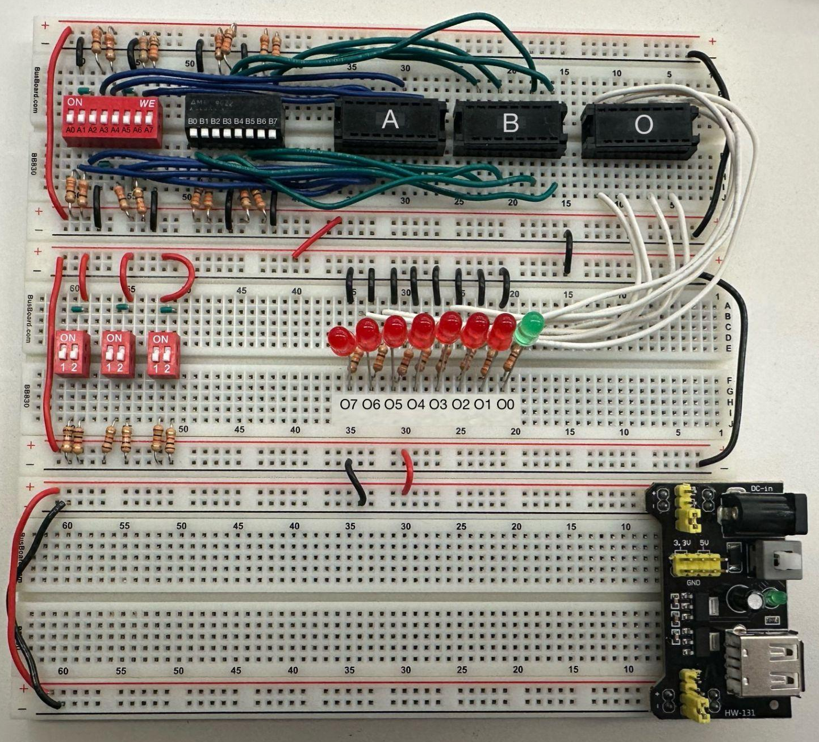
Test and Debug Circuit
How can the students verify that their implementation is correct?
For Hardware Labs
Created a tester circuit.
For Software Labs
Created test cases for each activity.

Slide 36
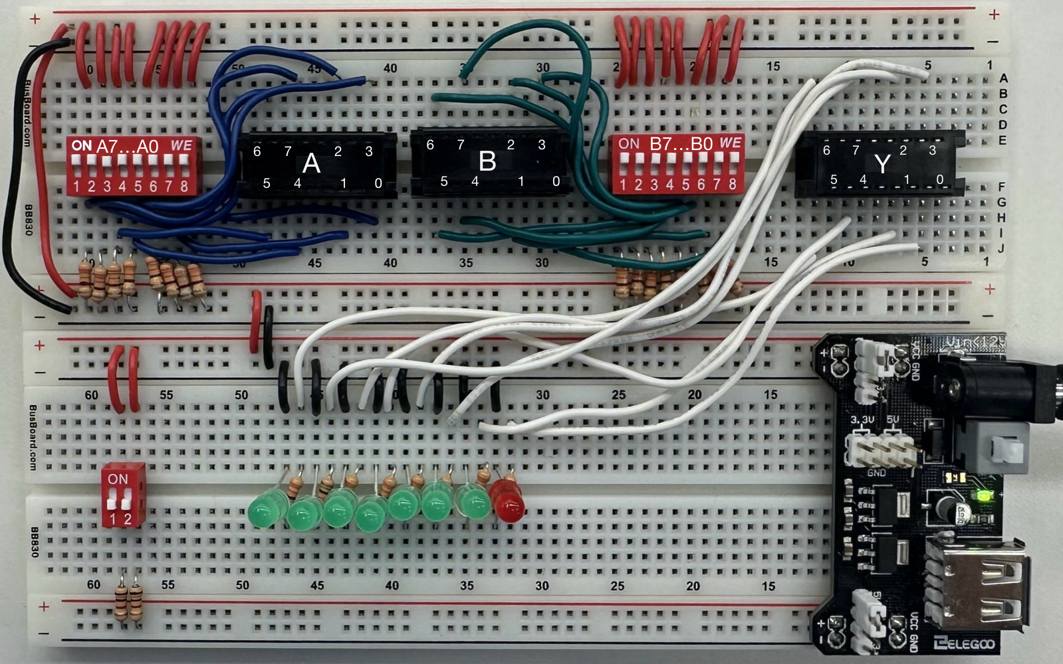
Test and Debug Circuit
Through testing and development of more labs we refined the design of our tester circuit to adjust for changing needs.

Slide 37
Get Feedback from Team and Client
What improvements can be made to the implementation?
Does the implementation need any changes?
Are there any logic errors or flaws in the implementation that need to be addressed?

Slide 38
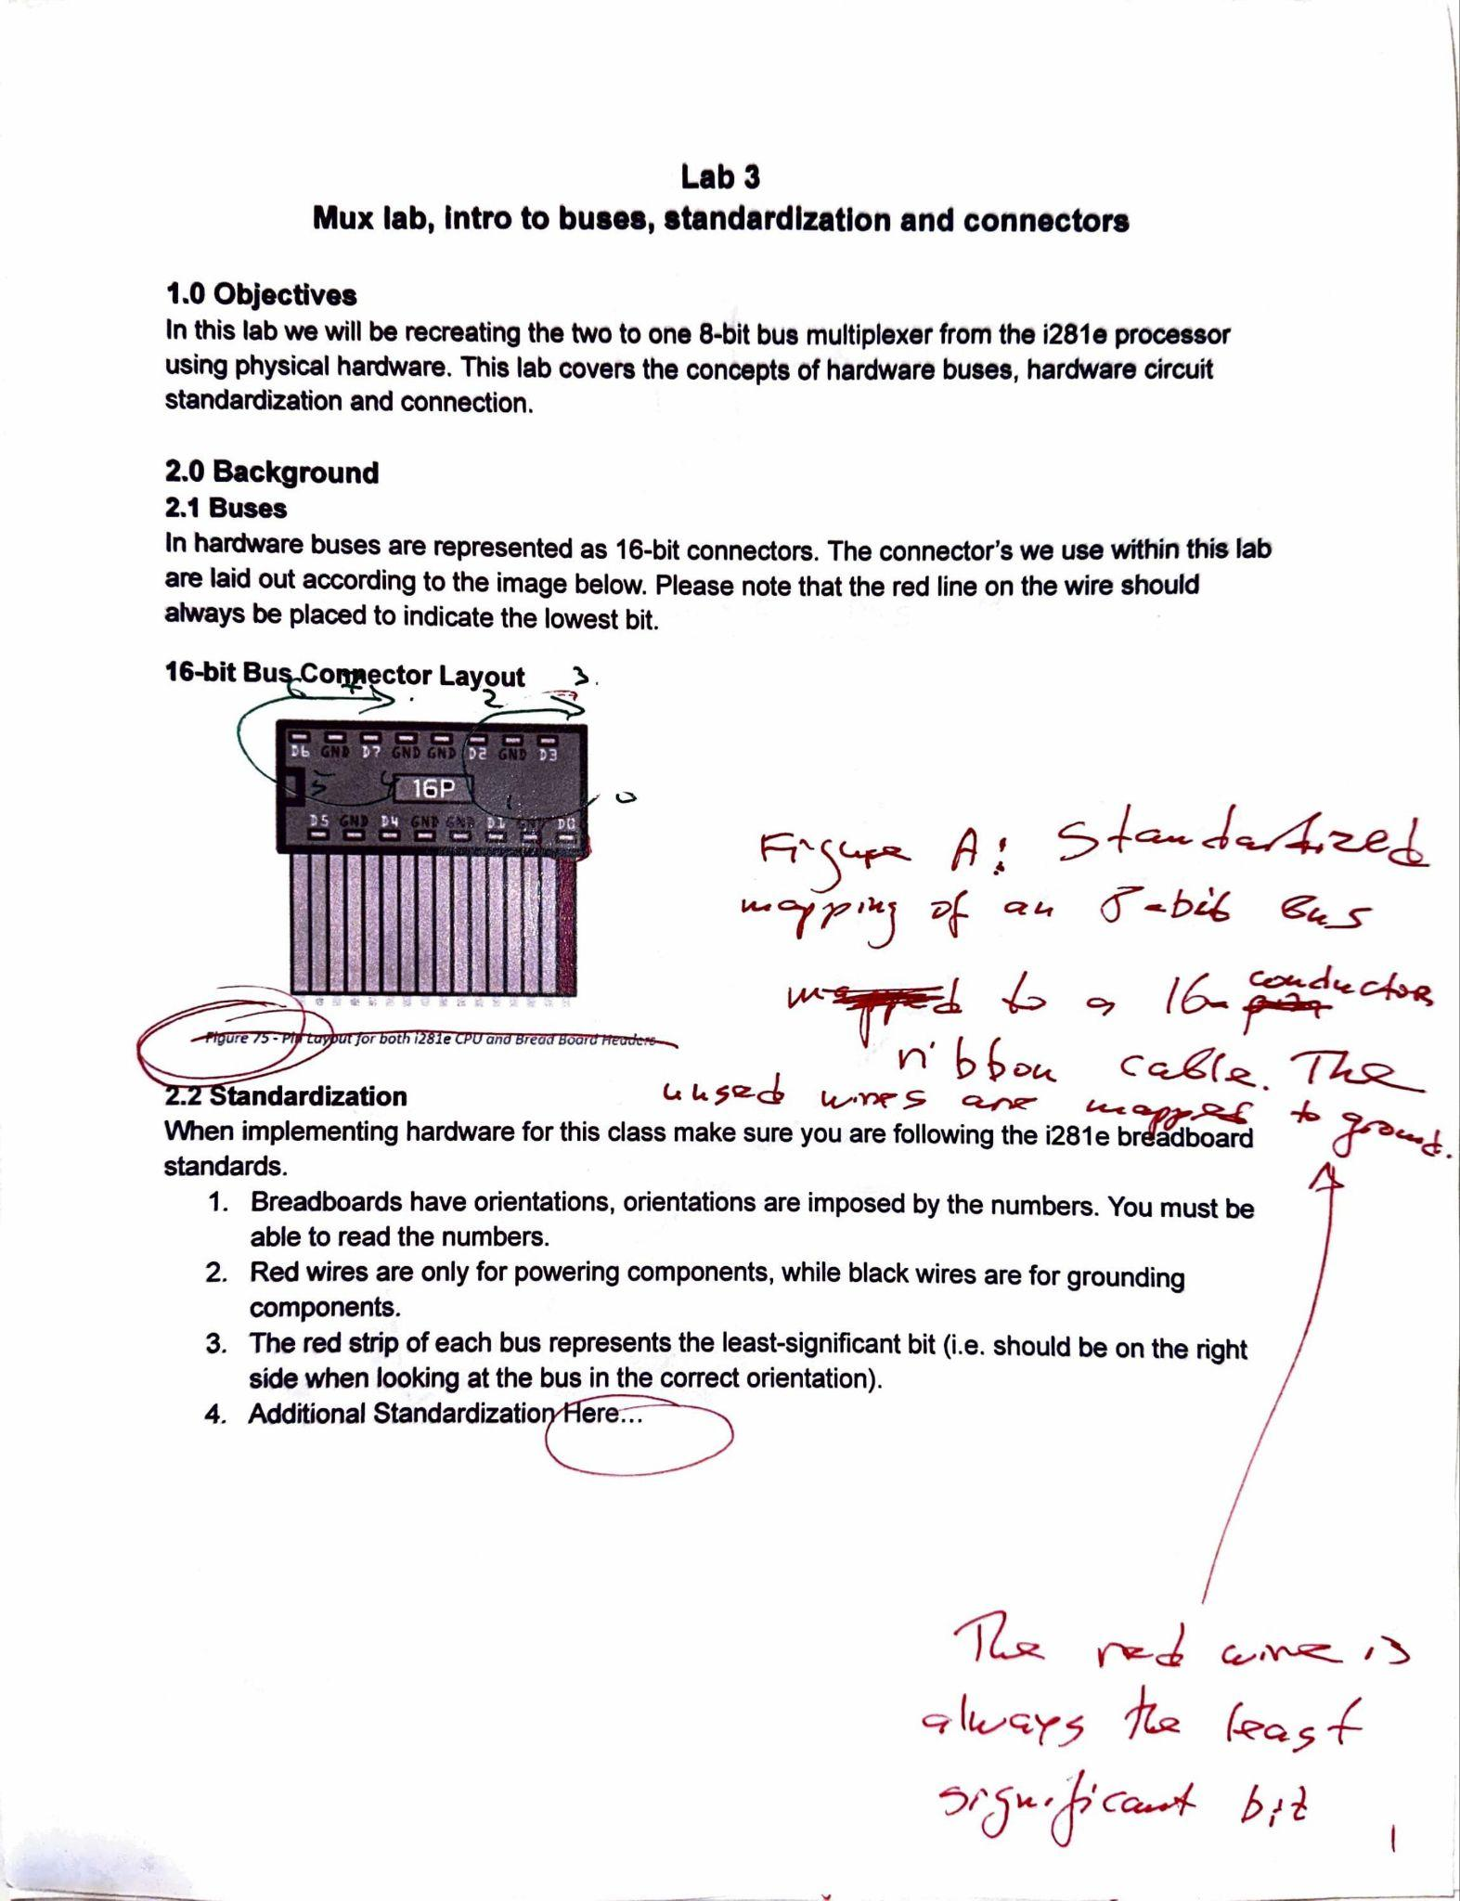
Document and Draft the Lab
Document circuit designs or program requirements and create instructions.
Add relevant background information and begin the pre-lab for the report.
Finalize testing procedure for the lab.
Get feedback from client on the draft.
Begin revisions on the draft until it is satisfactory.

Slide 39
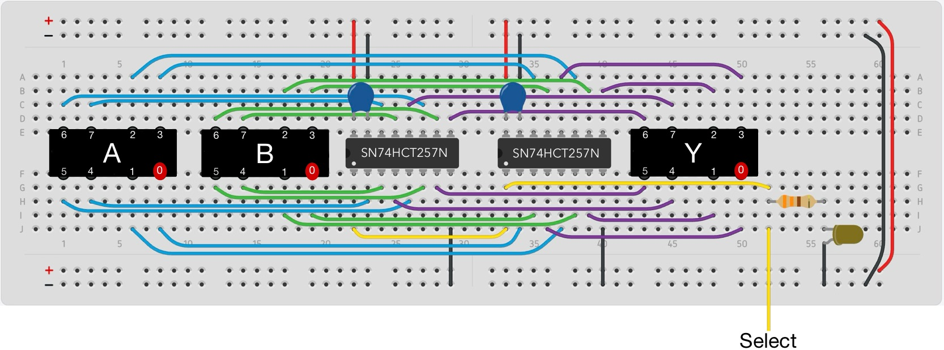
Test the Lab
Have some volunteers follow along the lab
See how long it takes them
Get feedback

Slide 40
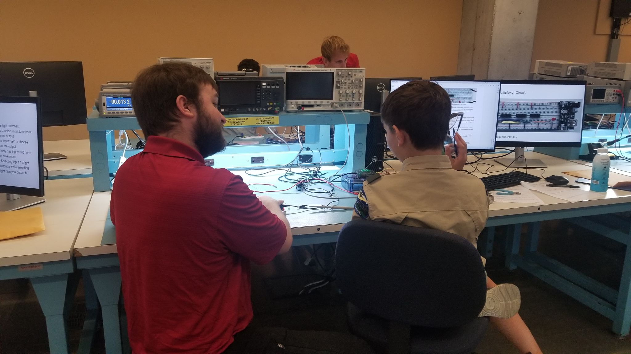
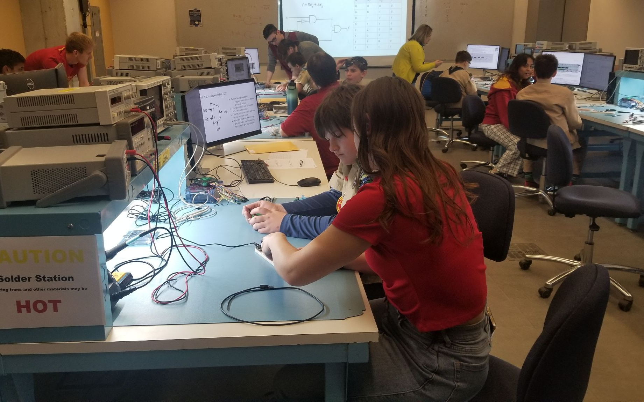
Outreach: BSA Electronic Merit Badge University, Iowa Space Grant

Slide 41
Accomplishments

Slide 42
Gantt Chart
Notes:
Gigi

Slide 43
Lab 1: Bitwise
Multiplexer
Notes:
Gigi

Slide 44
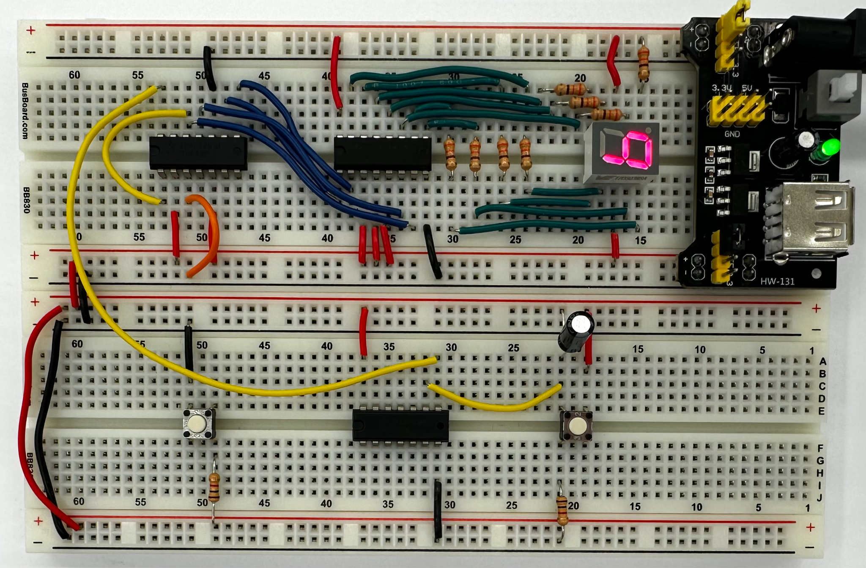
Lab 2:
Counting
& Debouncing
Notes:
Gigi

Slide 45
Lab 3: 8-Bit Bus
Multiplexor
Notes:
Gigi

Slide 46
Test Circuit
Notes:
Gigi

Slide 47
Lab 4:
Introduction to KiCAD
(Start of Mini-Project)
Notes:
Ethan

Slide 48
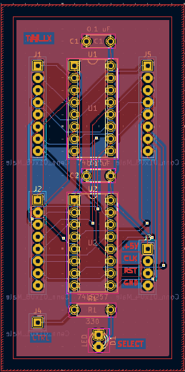
Lab 5: Routing a PCB
Notes:
Ethan

Slide 49
Mini-Project
Notes:
Ethan

Slide 50
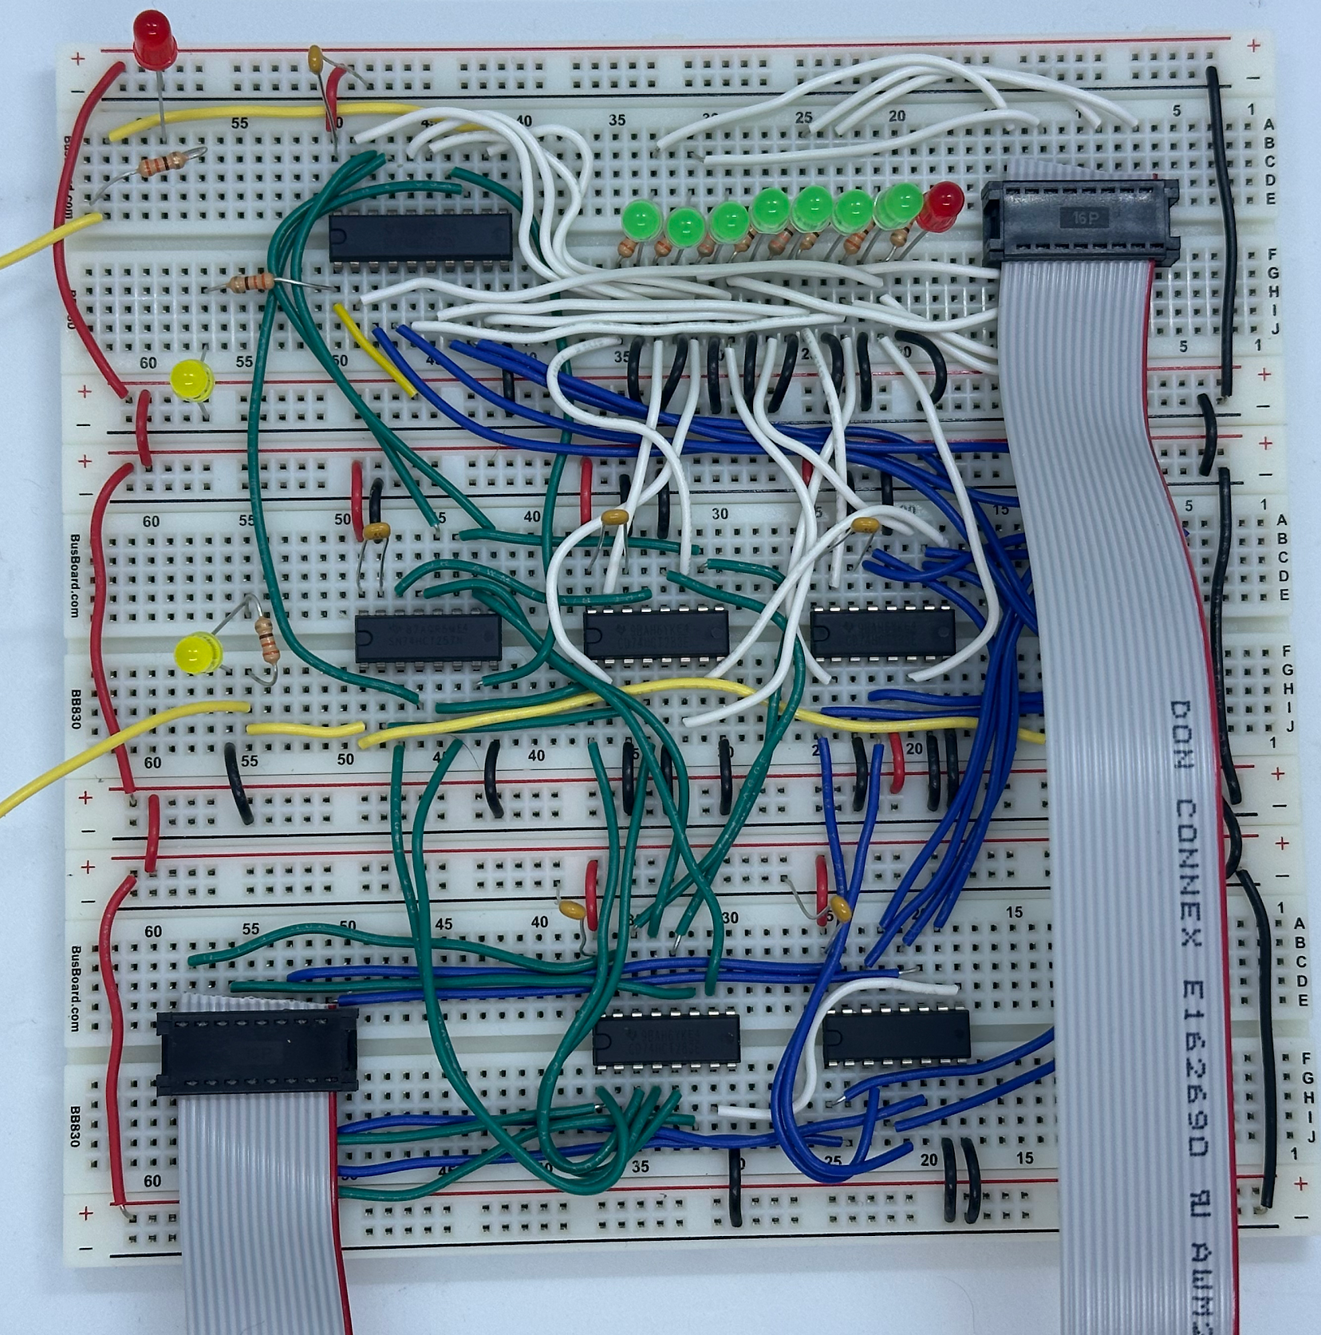
Lab 6 & 7:
Program Counter
Notes:
Tessa

Slide 51
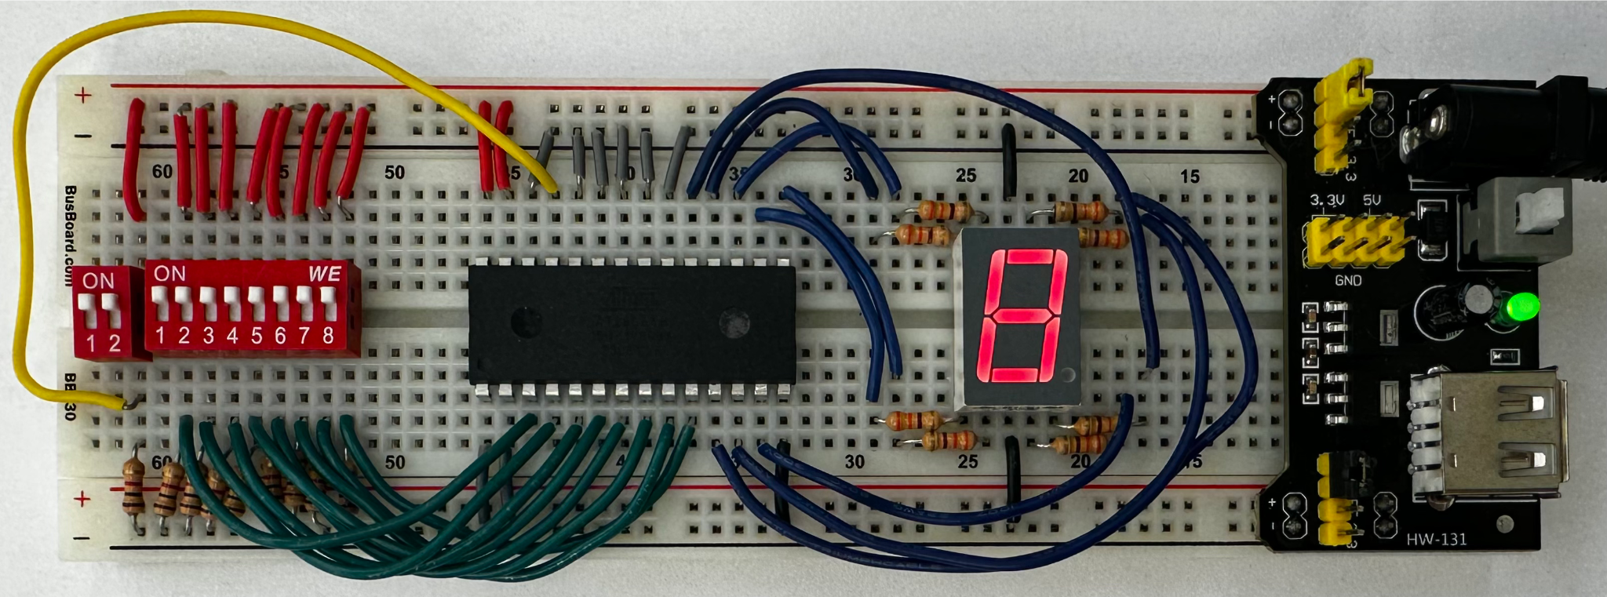
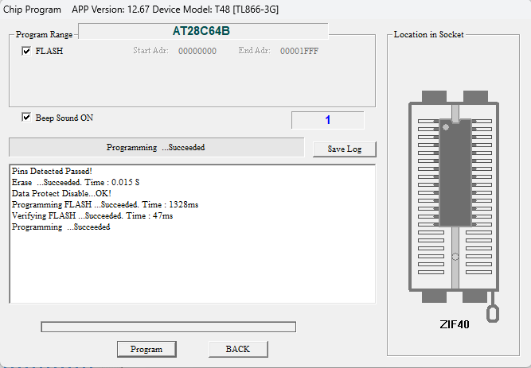
Lab 8:
EEPROM 7-Segment Decoder
Notes:
Tessa

Slide 52
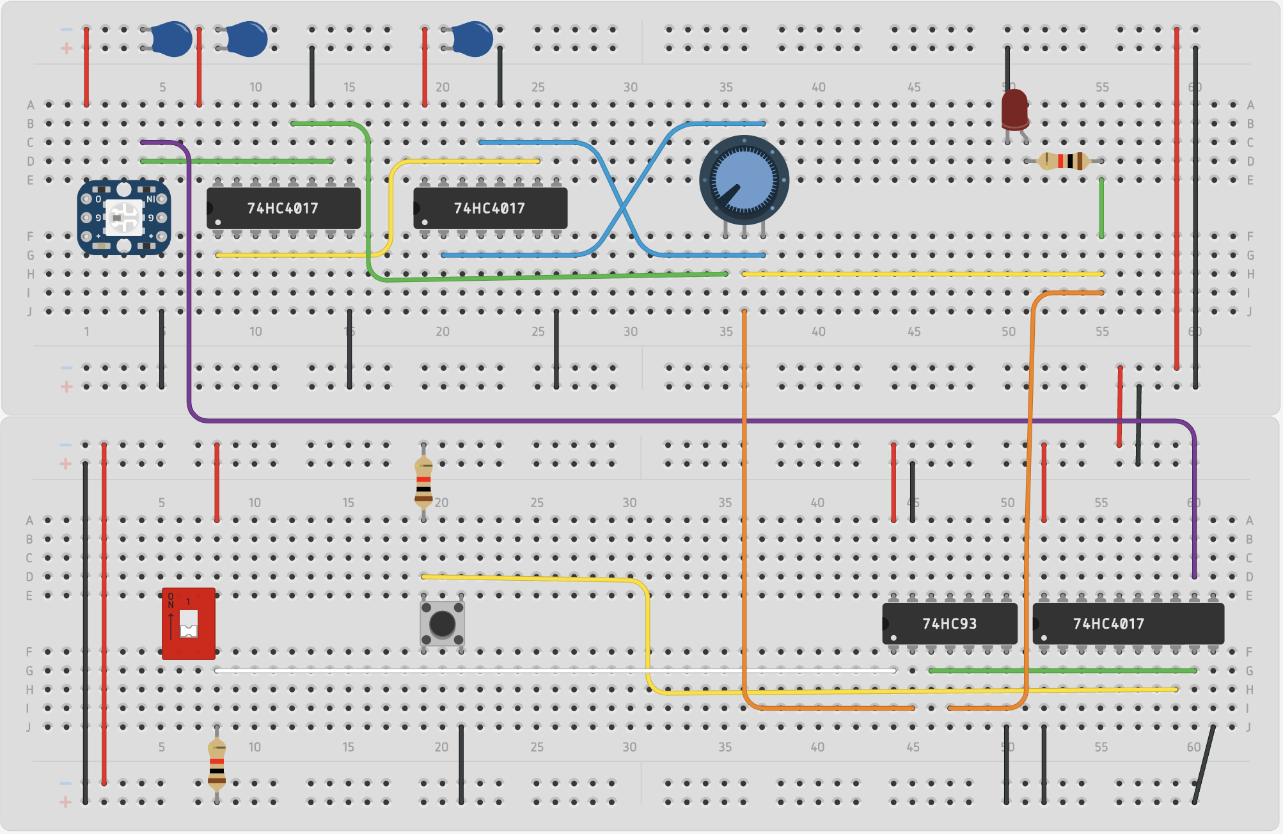
Lab 9: Clock
Notes:
Tessa

Slide 53
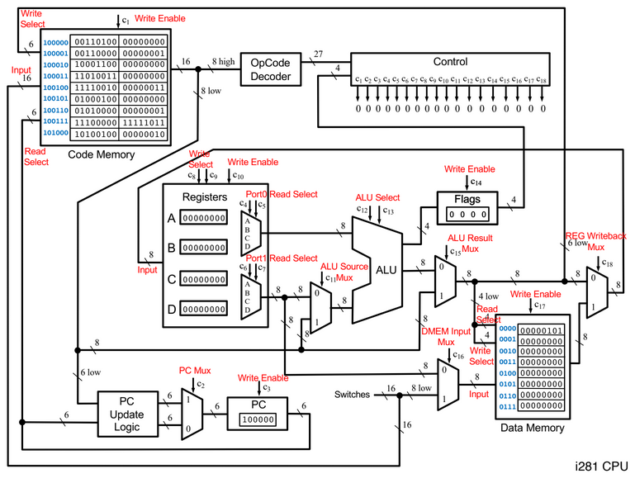
Lab 10: Assembly
Level Programming
Learn how to translate code from C to assembly that can run on the i281 simulator.
Notes:
Ariana

Slide 54
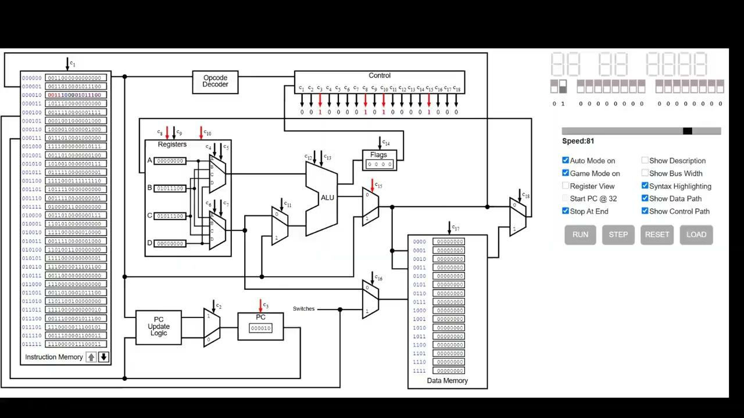
Lab 11: Video Game in Assembly
Implement a version of the video game flappy bird in assembly.
Teaches students to be mindful of the system architecture and available resources.
Notes:
Ariana

Slide 55
Conclusion

Slide 56
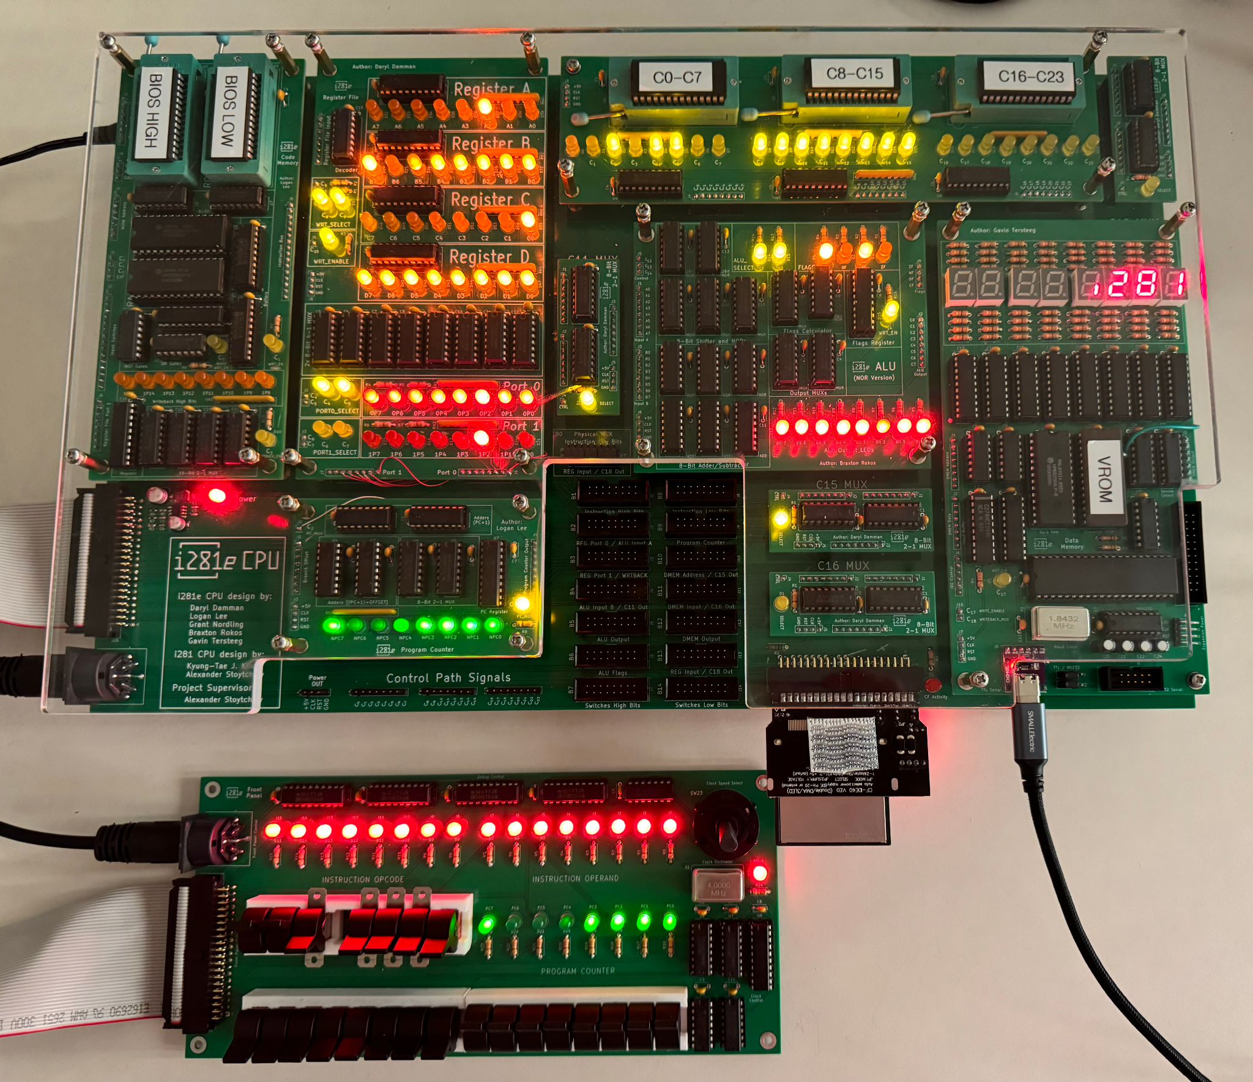
CprE 3710x Timeline by Week
Lab 8
Intro to Breadboards: 2-to-1 MUX
Counting, Decoding, & Debouncing
Standardization and Connectors: Bus MUX
Introduction to KiCAD (Start of Mini Project)
Mini-Project: Routing a PCB
Program Counter Part 1
Program Counter Part 2
EEPROMs: Program 7-Segment Decoder
Clock Circuit + Final Project Proposal
Assembly Level Programming
Video Game in Assembly
RAM Chips + Buffer
Thanksgiving Break
Final Project Pt 1
Final Project Pt 2
Lab 8
Final Project
Lab 8
Lab 3
Lab 6&7
Source: https://sdmay24-14.sd.ece.iastate.edu/

Slide 57
Questions?

Slide 58
i281e Processor Specifications
Clock Speed: 1Hz up to 2MHz (up to 2.5MHz overclock)
Processor fails around 2.75MHz
Power Requirements: 0.8A @ 5VDC (Input 5-12VDC)
Fuse for overcurrent protection @ 2A
Memory: 32 KW (64 KB) of Code RAM, 32 KB of Data RAM
Also includes 128 words of Code ROM for booting the system
Compact Flash: extended memory for long-term storage
Acts as the “hard disk” and stores the OS and File System for DOS/281

Slide 59
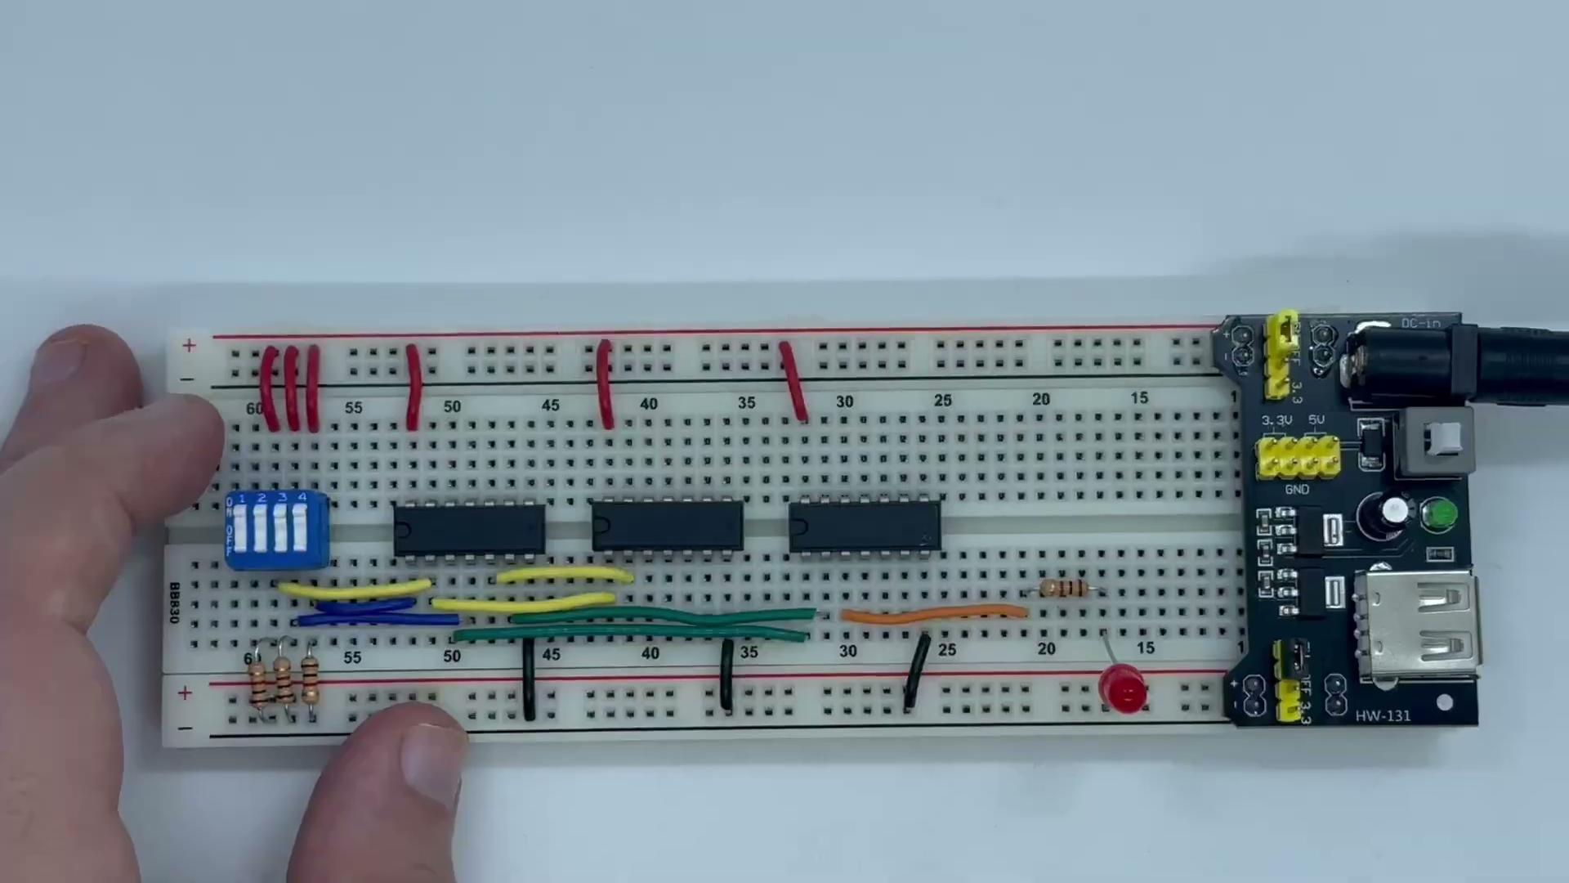
Lab 1:
Demo
Notes:
Flip x1 on → lights up
Select On → light off
Flip x2 → light on
X1 off, no change
Select off, light off
Select, x1, x2

Slide 60
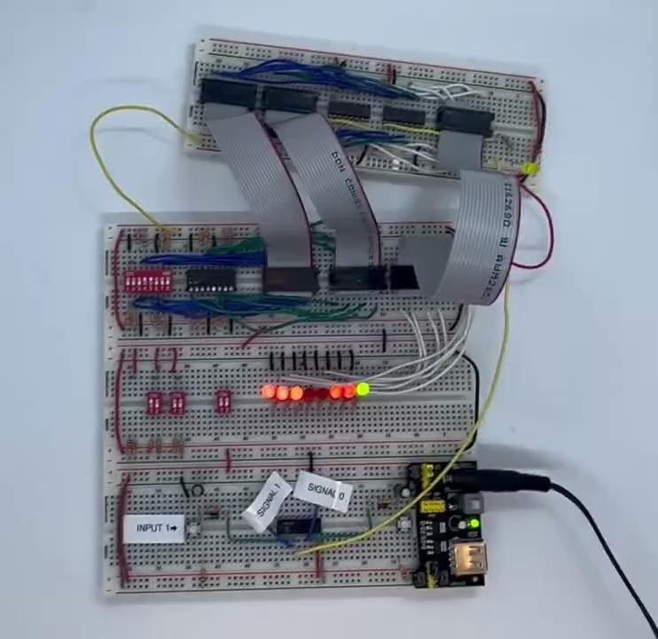
Lab 3:
Bus MUX Demo
Notes:
LEDS on to match input A
Change A and show LEDs change to match it
Hit select and show second input
Change second input and show output changed with it when input pressed

Slide 61
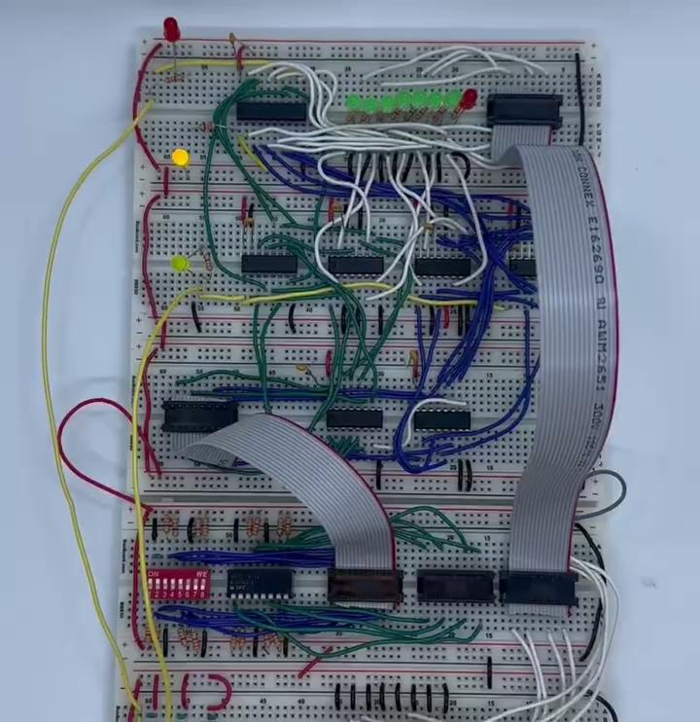
Lab 6 & 7:
Program Counter Demo
Notes:
Pan to show input buttons
Pan back up
Hit button 4 times and see incrementing
Turned on select and cycle through
Show the output now reflects the input bus which is the offset + 1

